Slide 1
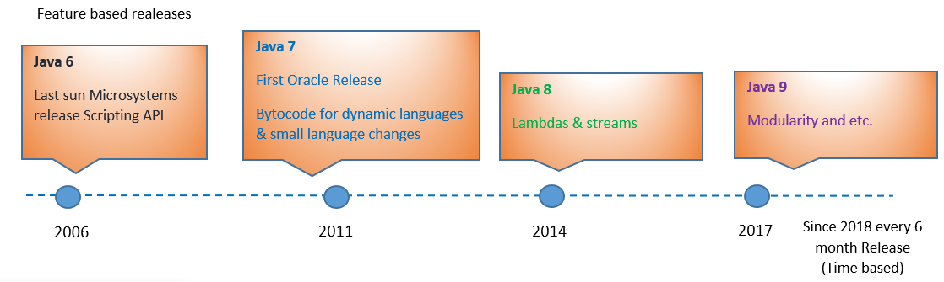
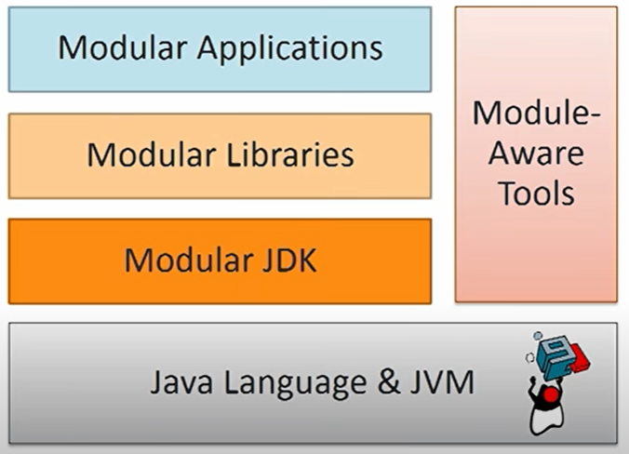
Java Features
https://github.com/azatsatklichov/Java-Features
Azat Satklichov
azats@seznam.cz,
http://sahet.net/htm/java.html
Notes:
JSLint can be found at http://www.JSLint.com/.
JavaScript statements are composed of: Values, Operators, Expressions, Keywords, and Comments.
JavaScript programs (and JavaScript statements) are often called JavaScript code.
var x, y, z; // Statement 1 x = 5; // Statement 2 y = 6; // Statement 3
var x = 5 * 10; //Statement 4
JavaScript uses the var keyword to declare variables.
An expression is a combination of values, variables, and operators, which computes to a value. E.g. 5 * 10 or x * 10
JavaScript variables are containers for storing data values.
All JavaScript variables must be identified with unique names. JavaScript identifiers are case-sensitive.
Creating a variable in JavaScript is called "declaring" a variable.
var carName;
Difference Between Unicode and UTF-8: Unicode is a character set. UTF-8 is encoding.
Unicode is a list of characters with unique decimal numbers (code points). A = 65, B = 66, C = 67, ....
This list of decimal numbers represent the string “ahello": 97 104 101 108 108 111
Encoding is how these numbers are translated into binary numbers to be stored in a computer:
UTF-8 encoding will store "hello" like this (binary): 01101000 01100101 01101100 01101100 01101111
Encoding translates numbers into binary . Character sets translates characters to numbers.

Slide 2


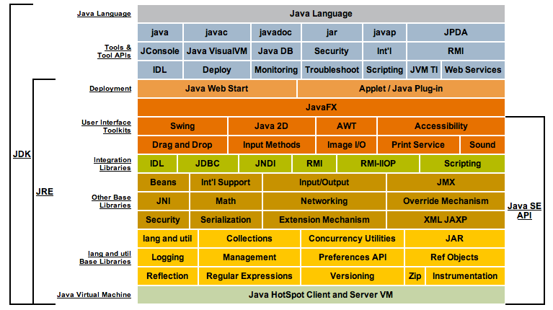
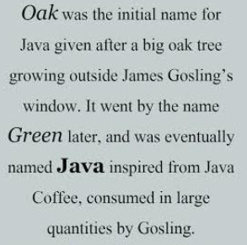


Sun Microsystems and Oracle
Java 6 - Last Sun Microsystems release 2006 (Scripting API)
27-Jan 2010 Oracle acquired Sun Microsystems - https://en.wikipedia.org/wiki/Sun_Microsystems
First Oracle release 2011, Java 7 - Bytecode for dynamic languages and some small mall language changes
2014 New Era for Java started with Java 8 release – Lambdas, Streams, new Date Time API, and many more

Slide 3
JAVA 8 and Beyond
JAVA 10 – Last free version of JDK
≠
Goal: convergence of Oracle & OpenJDK codebases
Oracle JDK 8,9,10
Binary Code License
Paid
Oracle Support Contract
Open JDK 8,9, 10
GPL v2
Free
Amazon Corretto, AtoptOpen JDK (Prebuilt OpenJDK), RedHat Open JDK, ..
Since version 11, Oracle contributes some commercial features to OpenJDK community. Oracle JDK “commercial features” such as Flight Recorder, Java Mission Control, and Application Class-Data Sharing, as well as the Z Garbage Collector, are now available in OpenJDK. Therefore, Oracle JDK and OpenJDK builds are essentially identical from Java 11 onward.
=
Oracle JDK 11
Binary Code License
Paid
LTS Support by Java SE Subscription
Open 11
GPL v2
Free
LTS Support by Amazon Corretto, AtoptOpen JDK (Prebuilt OpenJDK), RedHat Open JDK ..
Main differences between Oracle JDK 11 (A) and Open JDK 11 (B)
(A) emits a warning when using the -XX:+UnlockCommercialFeatures option, with (B) builds this option results in an error
(A) offers a configuration to provide usage log data to the “Advanced Management Console” tool
(A) required third party cryptographic providers to be signed by a known certificate, while cryptography framework in (B) has an open cryptographic interface, which means there is no restriction as to which providers can be used
(A) will continue to include installers, branding, and JRE packaging, whereas (B) builds are currently available as zip and tar.gz files
The javac –release command behaves differently for the Java 9 and 10 targets due to the presence of some additional modules in (A)’s release
The output of the java –version and java -fullversion commands will distinguish Oracle's builds from OpenJDK builds
Notes:
Mark Reinhold Architect, Alex Buckley
https://www.oracle.com/java/technologies/java-se-support-roadmap.html
Changes Since Java 11
As we can see in Oracle's blog post, there are some important changes starting with Java 11.
First of all, Oracle will change its historical “BCL” license with a combination of an open source GNU General Public License v2, with the Classpath Exception (GPLv2+CPE) and commercial license when using the Oracle JDK as part of an Oracle product or service, or when open source software is not welcome.
Each license will have different builds, but those will be functionally identical with only some cosmetic and packaging differences.
Also, traditionally “commercial features” such as Flight Recorder, Java Mission Control, and Application Class-Data Sharing, as well as the Z Garbage Collector, are now available in OpenJDK. Therefore, Oracle JDK and OpenJDK builds are essentially identical from Java 11 onward.
Let's check out the main differences:
https://medium.com/@javachampions/java-is-still-free-c02aef8c9e04

Slide 4
JAVA 8 and Beyond
Since Java SE 10, every six months there is a new release. Not all releases will be the Long-Term-Support (LTS) releases, it will happen only in every three years. Java SE 17 is the latest LTS version
Oracle JDK
Contains more tools than the standalone JRE as well as the other components needed for developing Java applications. Oracle strongly recommends using the term JDK to refer to the Java SE (Standard Edition) Development Kit
Open JDK
OpenJDK is a free and open-source implementation of the Java SE Platform Edition. Initially, it was based only on the JDK 7. But, since Java 10, the open-source reference implementation of the Java SE platform is the responsibility of the JDK Project. E.g AtoptOpen JDK (Prebuilt OpenJDK), Amazon Corretto, RedHat Open JDK .
Oracle JDK vs. OpenJDK
Release Schedule: Oracle will deliver releases every three years(hata???), while OpenJDK will be released every six months. Oracle provides long term support for its releases. On the other hand, OpenJDK supports the changes to a release only until the next version is released.
WoooW LTS 2 years – from Java 2017 - https://www.oracle.com/emea/news/announcement/oracle-releases-java-17-2021-09-14/
https://www.oracle.com/fi/news/announcement/oracle-releases-java-17-2021-09-14/
https://www.oracle.com/java/technologies/java-se-support-roadmap.html, https://en.wikipedia.org/wiki/Java_version_history
Licenses: Oracle JDK is under Oracle Binary Code License Agreement, whereas OpenJDK has the GNU GPL version 2 with a linking exception.
Performance: Even though no real technical difference exists in these two, Oracle JDK is much better regarding responsiveness and JVM performance. It puts more focus on stability due to the importance it gives to its enterprise customers. OpenJDK, in contrast, will deliver releases more often. As a result, we can encounter problems with instability. Based on community feedback, we know some OpenJDK users have encountered performance issues.
Features: Besides standard features and options, Oracle JDK provides Flight Recorder, Java Mission Control, and Application Class-Data Sharing features, while OpenJDK has the Font Renderer feature. Also, Oracle has more Garbage Collection options and better renderers.
Development and Popularity: Oracle JDK is fully developed by Oracle, whereas the OpenJDK is developed by Oracle, OpenJDK, and the Java Community. However, the top-notch companies like Red Hat, Azul Systems, IBM, Apple Inc., SAP AG also take an active part in its development.
When it comes to the popularity with the top companies that use Java Development Kits in their tools, such as Android Studio or IntelliJ IDEA, the Oracle JDK used to be more preferred, but both of them have switched to the OpenJDK based JetBrains builds.
On the other hand, major Linux distributions (Fedora, Ubuntu, Red Hat Enterprise Linux) provide OpenJDK as the default Java SE implementation.
Notes:
Open JDK
OpenJDK is a free and open-source implementation of the Java SE Platform Edition. It was initially released in 2007 as the result of the development that Sun Microsystems started in 2006.
Certainly, we should emphasize that the OpenJDK is an official reference implementation of a Java Standard Edition since version SE 7.
Initially, it was based only on the JDK 7. But, since Java 10, the open-source reference implementation of the Java SE platform is the responsibility of the JDK Project. And, just like for the Oracle, the JDK Project will also deliver new feature releases every six months.
We should note that before this long-running project, there were JDK Release Projects that released one feature and then got discontinued.
Let's now check out the OpenJDK versions:

Slide 5
New Features in JAVA 8 and Beyond, https://github.com/azatsatklichov/Java-Features
Functional Interfaces, Lambdas Expressions & Method references
Stream API, New Date-Time API (migrate from java.util.Date -> java.time)
Process API
Optional, Collection Factory Methods
Modular JDK – biggest change ever made to Java (Language, Compiler, VM, Tooling)
Local var
HTTP Client
Docker Awarene -JVMs are now aware of being run in a Docker container
New Performance profile and Security features, TLS 1.3, .. updates
Continious JVM Implrovements: G1 GC, ZGC, Shebandoah, ..
Tools: FlightRecorder, Java Mission Control, jshell, jDeps, jpackager, ..
Language Improvements, Deprecations & Removals
TLS 1.3, ..
Records, Switch Expressions, Text Blocks, ..
Source code: https://github.com/azatsatklichov/Java-Features/tree/master/src/main/java/features/in/java8

Slide 6
When Migrating Java to Beyond Java 8
Build tools: Maven min. version 3.8.0 , <configuration> <release>11</release> </configuration> , Gradle version 5 , or Docker image: maven:3-openjdk-11
Plugins, .. Eclipse or IntelliJ newer version
Modularity (internally) – to be prepared to next 20 years
Deprecated APIs (Base64, SecurityConst, enterprise APIs-CORBA, JAXB,JTA, so use Jakarta EE)
Removed ones
Use jdeps to finds dependencies, to migrate ..
Try run on Java 11 with: --illegal-access=deny (not dependent on internals)
Start using Java 11 features like List.of(), etc.
LTS to LST is good practice e.g. Java 11 -> Java 17 -> Java 23. But you can use non-LST
So still aware of non-LST versions (Java 13,14,15,16, 17(next LST), 18, ..), what is new, removed, deprecated, ..
Plan your FUTURE
In case to deep dive in JVM, use visualvm towith installing plugins visualgc and grallvm

Slide 7
New Features (JEPs) in JAVA 9
102: Process API Updates 110: HTTP 2 Client 143: Improve Contended Locking 158: Unified JVM Logging 165: Compiler Control 193: Variable Handles 197: Segmented Code Cache 199: Smart Java Compilation, Phase Two 200: The Modular JDK 201: Modular Source Code 211: Elide Deprecation Warnings on Import Statements 212: Resolve Lint and Doclint Warnings 213: Milling Project Coin 214: Remove GC Combinations Deprecated in JDK 8 215: Tiered Attribution for javac 216: Process Import Statements Correctly 217: Annotations Pipeline 2.0 219: Datagram Transport Layer Security (DTLS) 220: Modular Run-Time Images 221: Simplified Doclet API 222: jshell: The Java Shell (Read-Eval-Print Loop) 223: New Version-String Scheme 224: HTML5 Javadoc 225: Javadoc Search 226: UTF-8 Property Files 227: Unicode 7.0 228: Add More Diagnostic Commands 229: Create PKCS12 Keystores by Default 231: Remove Launch-Time JRE Version Selection 232: Improve Secure Application Performance 233: Generate Run-Time Compiler Tests Automatically 235: Test Class-File Attributes Generated by javac 236: Parser API for Nashorn
267: Unicode 8.0 268: XML Catalogs 269: Convenience Factory Methods for Collections
270: Reserved Stack Areas for Critical Sections 271: Unified GC Logging 272: Platform-Specific Desktop Features 273: DRBG-Based SecureRandom Implementations 274: Enhanced Method Handles 275: Modular Java Application Packaging 276: Dynamic Linking of Language-Defined Object Models 277: Enhanced Deprecation 278: Additional Tests for Humongous Objects in G1 279: Improve Test-Failure Troubleshooting 280: Indify String Concatenation 281: HotSpot C++ Unit-Test Framework 282: jlink: The Java Linker 283: Enable GTK 3 on Linux 284: New HotSpot Build System 285: Spin-Wait Hints 287: SHA-3 Hash Algorithms 288: Disable SHA-1 Certificates 289: Deprecate the Applet API 290: Filter Incoming Serialization Data 291: Deprecate the Concurrent Mark Sweep (CMS) Garbage Collector 292: Implement Selected ECMAScript 6 Features in Nashorn 294: Linux/s390x Port 295: Ahead-of-Time Compilation 297: Unified arm32/arm64 Port 298: Remove Demos and Samples 299: Reorganize Documentation
237: Linux/AArch64 Port 238: Multi-Release JAR Files
240: Remove the JVM TI hprof Agent 241: Remove the jhat Tool 243: Java-Level JVM Compiler Interface 244: TLS Application-Layer Protocol Negotiation Extension 245: Validate JVM Command-Line Flag Arguments 246: Leverage CPU Instructions for GHASH and RSA 247: Compile for Older Platform Versions 248: Make G1 the Default Garbage Collector 249: OCSP Stapling for TLS 250: Store Interned Strings in CDS Archives
251: Multi-Resolution Images 252: Use CLDR Locale Data by Default 253: Prepare JavaFX UI Controls & CSS APIs for Modularization 254: Compact Strings 255: Merge Selected Xerces 2.11.0 Updates into JAXP 256: BeanInfo Annotations
257: Update JavaFX/Media to Newer Version of GStreamer 258: HarfBuzz Font-Layout Engine 259: Stack-Walking API 260: Encapsulate Most Internal APIs 261: Module System 262: TIFF Image I/O 263: HiDPI Graphics on Windows and Linux 264: Platform Logging API and Service 265: Marlin Graphics Renderer 266: More Concurrency Updates
Biggest changes in Java ever (Language, Compiler, VM, Tooling, …), Language and Library Improvements, New APIs, ..
Source code: https://github.com/azatsatklichov/Java-Features/tree/master/src/main/java/features/in/java9,
And for Java9 see also: ModularJavaProjects
Notes:
https://mkyong.com/java/what-is-new-in-java-16/#jep-392-packaging-tool
MODULES (to address technical depts. In last 20 years, .. ), Module system is optional
Jshell,
Libraries and Language Improvements,
New APIs
Desktop Java Enhancements
Performance & Security
http://tutorials.jenkov.com/java/modules.html#compiling-a-java-module
https://developer.ibm.com/tutorials/java-modularity-5/
https://www.baeldung.com/java-9-modularity
https://www.developer.com/java/data/using-a-java-9-module-as-a-jar-file/

Slide 8
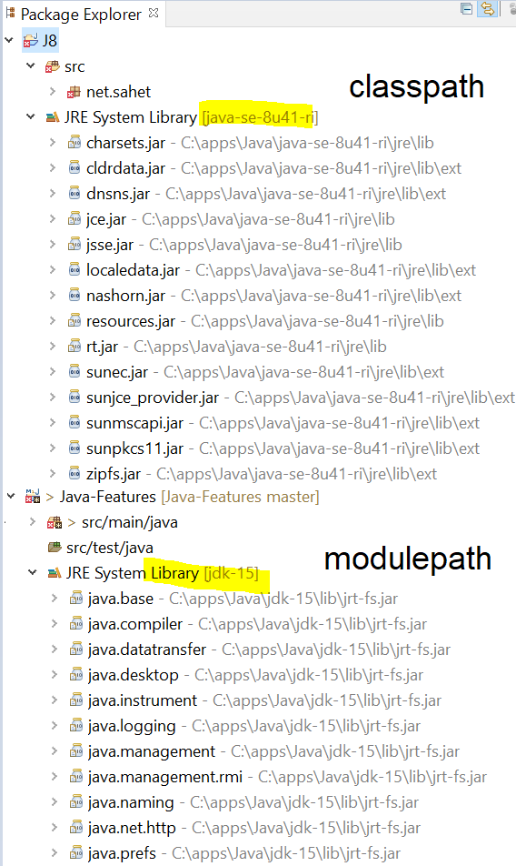

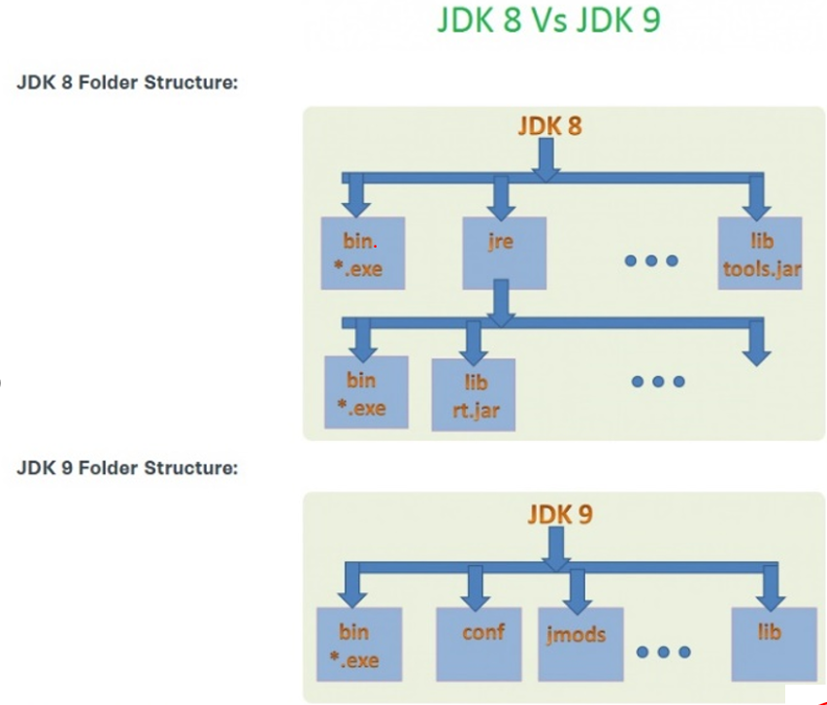
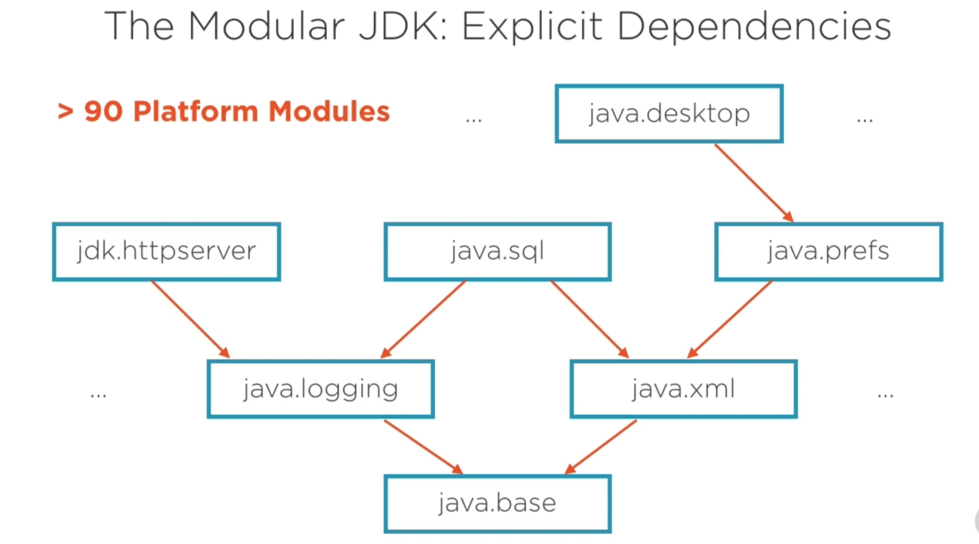
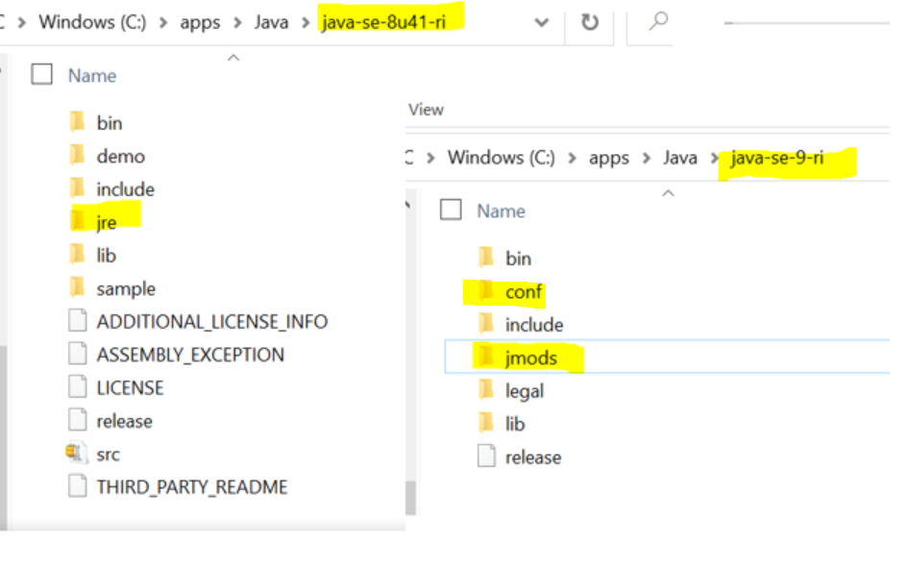
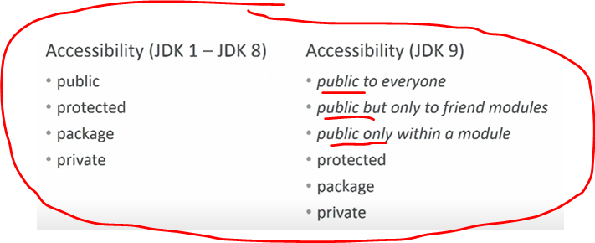
Compare JDK 8 and JDK 9
Before Modular JDK
one rt.jar (20 yrs. Until 2017)
Too big, heavy (entangled classes), technical depth.
must be backward-compatible, internal classes
standard&ee mix)
CLASSPATH problems (missing jars, jar hells, … ), JAR, WAR, EAR, …
Java 8 compact1|2|3 (tries to reduce, but still BIG). Same Docker Java Images but still runtime size is big. Also project OSGi is a way of Modularization, but it is based on current Java. So, Best option is Jigsaw JAVA.
Modular JDK
JDK modularized, modular apps (than monolithic)
Create own modules (modularize apps)
Using module system is optional (unnamed module)
All modules has implicitly dependency to java.base (foundation).
E.g. Remember java Object class.
Notes:
Makes the app more reliable by eliminating runtime-errors. E.g. ClassNotFoundException
No difference between JDK and JRE since Java 9, they have same structure
Real power towards modular programming → modular programming than monolithic → go to REAL MICRO-MICRO services
Tools.jar, rt.jar, dt.jar removed.
OSGi and JIGSAW differences
Classpath problem (JAR HELLL)
big, can access the world , security
If jars missing only until runtime (use time ) we declare, e.g. MAVEN - SYSTEM option, or etc.
Versioning conflicts - …
JAR files like rt.jar etc are too big to use in small devices and applications.
As JDK is too big, our applications or devices are not able to support better Performance.
There is no Strong Encapsulation in the current Java System because “public” access modifier is too open. Everyone can access it.
As JDK, JRE is too big, it is hard to Test and Maintain applications.
As the public is too open, They are not to avoid the accessing of some Internal Non-Critical APIs like sun.*, *.internal.* etc.
In JDK-9 folder structure (NO rt.jar, tools.jar). JER is separated into different folders (config, lib, … ).
Has new folder jmods – contains set of modules, …
Restricted by backward compatibility, internally, you can not enforce to stop, …
As we know, Current JDK system is too big. So they have decided to divide JDK itself into small modules to get a number of benefits (We will discuss them soon in the coming sections).
Classptah-mechanism for configuration, classpath cannot express relationships between components. If necessary component is missing, it will not be discovered until used.
Classpath also allows classes in the same package to be loaded from different components, leading to unpredictable behavior and difficult to find/diagnose it.
In modular approach, allows a component to declare that it depends other components explicitly.
CLASSPATH HELL – or JAR HELL
JRE – folder in Java 8 removed, and replaced witj jmods+conf folder in Java 9. jmod-folder contains runtime images of JDK modules, and conf-folder contains config+property files which were before under JRE folder
Contents of jrebin, and jrelib have bin moved to lib and bin directories.
Module is named, after groups related items becomes self sufficient)
Main aim of the Jigsaw project is to introduce concept of modularity: support for creating modules in Java and then apply the same to the JDK; that is modularize the JDK.
Benefits of modularism:
Stronger encapsulation (information hiding) modules can access only those parts of the module that have been available for use. So the public classes in a package are not public unless package is explicitly exported in the module-info-file. Can not be broken with reflection unless module is open-module or packages made open.
Clear dependencies (via requires clause)
Combining modules to create smaller runtimes which can be easily scaled to smaller computing devices
Makes the app more reliable by eliminating runtime-errors. E.g. ClassNotFoundException
JEP 200 – modular JDK: applies the Java platform module system to modularize JDM into set of modules, that can be combined at compile time, build time or runtime
JEP 201 – modular source code. Modularizes JDK source code into modules and enhances the build tools to compile the modules. Current (Java 1-8) is TOO BIG,
JEP 220 – modular runtime images: This restructures the JDK and JRE runtime images to accomodate modules and to improve performance, security, and maintainability
JEP 260 – encapsulate most internal APIS: This allows a lot of internal APIs to be accessed directly or via reflection.
JEP 261 – module system: Implements module system Java spec.
JEP 282 – jlink, the Java Linker: This allows packaging modules and their dependencies into smaller run times.
Jigsaw project is going to introduce completely new concept of Java SE 9: Java Module System.

Slide 9
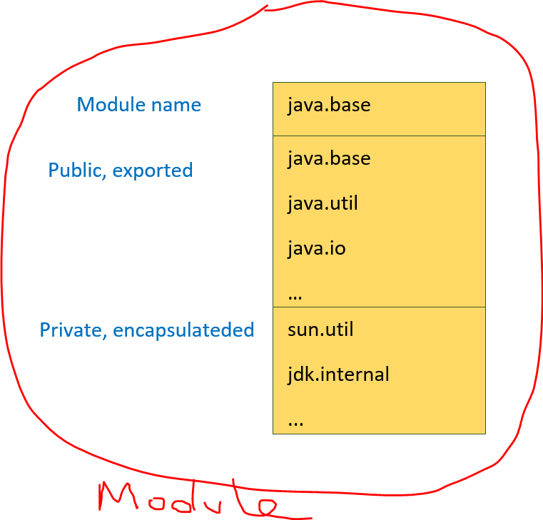
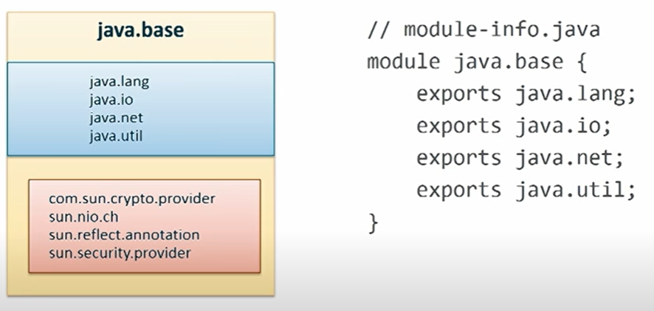

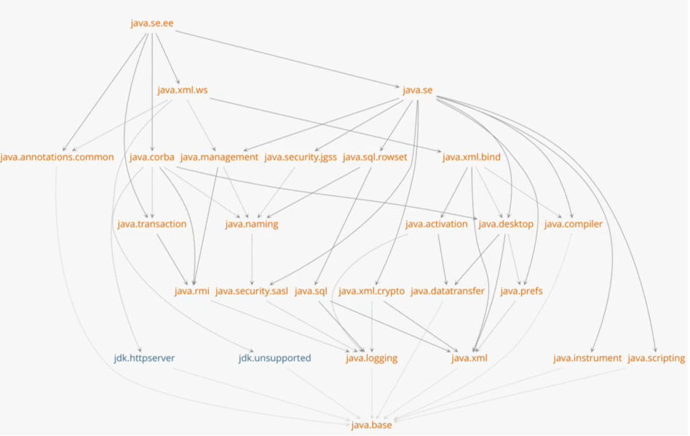
Modular JAVA (Project Jigsaw [J7])
//module-info.java (module descriptor)
Jigsaw project is going to introduce completely new concept - Java Module System.
JEPs: 200 (modular JDK), 201(modular src-code [rt.jar is too big]), 220(modular runtime images), 260(encapsulate most internal APIs), 261(module system – mod. app), 282(jlink – java linker)
JSR 376 (Jigsaw - Java Platform Module System)
//Java 9 is modular, 11 – JEE modules removed
Module system (module is named, groups related code [data+resources, mod-desc) & self sufficient [supports SRP], designed for re-use )
Small and clear, compact runtime images, reliable config (no cyclic dep., explicit dependency info can be used in compile and runtime)
Increased security (can’t use internals), improved performance
95 < modules (jdk.*, java.* [java spec modules], java.base – default to all)
Easy of deprecation (java.corba, …), Future proof (ship, try incubators)
Why jar not enough (has name but no meaning at Runtime, groups code but no encapsulation, not self contained - lack of explicit dependency in Java [yes by maven OK])
3 cornerstones of modularity: Stronger encapsulation, reliable-config (clear explicit dependencies - via requires clause), well-def. interfaces)
Module Types: System, Application, Automatic, Unnamed
java --list-modules //system modules
java --describe-module java.sql
In OOP Object, FP – Lambda (Function), Module system - Module
Notes:
Jigsaw also introduces support for class loader names.
For AUTOMATIC Modules, module names are derived from jar names, but still can not be used in building IMAGEs.
Class loaders can have optional names. If name not specified, it has no name.
ClassLoader.getName()
The name of module’s class loader is always mentioned together with the module name and version in warning message or stack trace.
Jigsaw uses existing class loader. Just adds support for for class loader names.
It allows you to dind class by name in specific module. With help of
Class<?> findClass(String moduleName, String String name)
s
It is not allowed to have circular dependencies between modules. In other words, If module A requires module B, then module B cannot also require module A. The module dependency graph must be an acyclic graph.
The same Java package can only be exported by a single Java module at runtime. In other words, you cannot have two (or more) modules that export the same package in use at the same time. The Java VM will complain at startup if you do.
Having two modules export the same package is also sometimes referred to as a split package. By split package is meant that the total content (classes) of the package is split between multiple modules. This is not allowed.
Module Types
There are four types of modules in the new module system:
System Modules – These are the modules listed when we run the list-modules command above. They include the Java SE and JDK modules.
Application Modules – These modules are what we usually want to build when we decide to use Modules. They are named and defined in the compiled module-info.class file included in the assembled JAR.
Automatic Modules – We can include unofficial modules by adding existing JAR files to the module path. The name of the module will be derived from the name of the JAR. Automatic modules will have full read access to every other module loaded by the path.
Unnamed Module – When a class or JAR is loaded onto the classpath, but not the module path, it's automatically added to the unnamed module. It's a catch-all module to maintain backward compatibility with previously-written Java code.
Concealed modules (via strong encapsulation)
Packages that are not exported are also referred to as hidden packages, or encapsulated packages.
Module system guarantees, there are no cycles:
Requires each-other: ….
For small devices : mobile phones, … no need android ,…
3 cornerstones of modularity:
Stronger encapsulation[hide internal classes, internal impl. dependencies],
clear explicit dependencies (via requires clause) []
well-def. interfaces [we want modules to talk each other via public APIs])
Each Java 9 Module have one and only one Module and one Module Descriptor. Unlike Java 8 Packages, We cannot create multiple modules into a single Module.
Module name can be - simple or compound ( use Reverse Domain Name pattern)
Module descriptor contains module metadata
Reliable Configuration: One of the problems with the class-path mechanism for making program components available to a Java application is that it does not define the relationships between components, making it difficult to ascertain if all the necessary components have been specified.
Advantages of Java SE 9 Module System
As Java SE 9 is going to divide JDK, JRE, JARs etc, into smaller modules, we can use whatever modules we want. So it is very easy to scale down the Java Application to Small devices.
- Ease of Testing and Maintainability.
- Supports better Performance.
- As public is not just public, it supports very Strong Encapsulation. (Don’t worry its a big concept. we will explore it with some useful examples soon).
- We cannot access Internal Non-Critical APIs anymore.
- Modules can hide unwanted and internal details very safely, we can get better Security.
- Application is too small because we can use only what ever modules we want.
- Its easy to support Less Coupling between components.
- Its easy to support Single Responsibility Principle (SRP).
What is modularity? Importance.
CLASSPATH troubles – a) very big path, no structure yet. How you know if all JARs are there. Untill you run and face missing class issue, you never know.
NoClassDefFoundError, ..
No separation between JARs, it is just an illusion. When JVM starts it puts all the classes from the classpath in BIG long list, and starts LOADING from that list.
What if multiple-JARs. Conflicting versions of classes (sometimes Weblogic, … JAR hell issues,…, or .. Exclude in pom.xml) JVM just takes first one from classpath.
c) Also classes can access to any classes in CLASSPATH. So some malicious 3-part library can access your code.
NO NOTION of STRONG ENCAPSULATION
ANSWER is MODULARITY
Monolithic apps are: Hard to understand, maintain, no way not to keep live during deployment without shutdown, no flexibility
JAR file (has name, groups related code) – even though at runtime no meaning
JAR file has name, its file name, but this file name has no meaning at runtime, JVM loads all JAR file into single THREAD CLASSPATH without regarding to different names.
JAR files on CLASSPATH can use any CLASSES in ANY JAR file, you can not express it in JAR file, that is why one of reason - CLASSPATH is fragile (broken)
WEAK boundaries - JAR file can access any file from ANY JAR file. Just on it different WAR file (different CLASSLOADER), but EAR file has same CLASSLOADER (common lib, … )
MODULE – groups related packages, or other modules, … Not exported packages are encapsulated, …
In Modular APP (1. Divide and Conquer 2. Clear Interfacing 3. Hide Implementation details 4. Reliable config )
In CLASSPATH – only dependencies can be knows at RUNTIME NOT
reliable config (only runtime)
Class-path vs. Module System Class Loading https://www.developer.com/design/developing-a-module-with-java-9-in-eclipse-ide-part-1/
Unlike the class-path–based class loading which loads all the classes specified in the class path, the module loads only the code of the required modules.
Unlike the class-path–based class loading, the module system does not let packages by the same name cause any interference. Only the packages exported by the modules declared a dependency on are loaded for access.
Small and compact - Reduced footprint
Ship incubator – jdk.incubator.httpclient
Complete picture of modules in JDK
BLUEs – may differe in different JDK, implementation specific
NO CYCLIC dependencies in the graph, now platform has very clean modularization. Cyclic dependencies are not supported by Java modular system.
CORBA – own module – can be deprecated, DESKTOP – gui, swing,…
As we know, Current JDK system is too big. So they have decided to divide JDK itself into small modules to get a number of benefits (We will discuss them soon in the coming sections).
Java.base – IMPLICITLY injected , no cyclic dependencies,
Java.corba – old but supported, ..
Are JAR files modules ? + they have a (file) name, + JAR also groups related code, - no explicit dependencies, weak boundaries, ..
At runtime, there is no way to enforce encapsulation,
One module – no dependencies anything at runtime, …
I have a sample project with a package java9unsafe and a module with the same name.
To use Unsafe, you need to add jdk.unsupported to your code’s module declaration:
1
module java9unsafe {
2
requires jdk.unsupported;
3
}
Modula has name, it groups related code and is self-contained: Python, Node.js, TypeScript
Classptah-mechanism for configuration, classpath cannot express relationships between components. If necessary component is missing, it will not be discovered until used.
Classpath also allows classes in the same package to be loaded from different components, leading to unpredictable behavior and difficult to find/diagnose it.
In modular approach, allows a component to declare that it depends other components explicitly.
JRE – folder in Java 8 removed, and replaced witj jmods+conf folder in Java 9. jmod-folder contains runtime images of JDK modules, and conf-folder contains config+property files which were before under JRE folder
Contents of jrebin, and jrelib have bin moved to lib and bin directories.
Module is named, after groups related items becomes self sufficient)
Main aim of the Jigsaw project is to introduce concept of modularity: support for creating modules in Java and then apply the same to the JDK; that is modularize the JDK.
Benefits of modularism:
Stronger encapsulation (information hiding) modules can access only those parts of the module that have been available for use. So the public classes in a package are not public unless package is explicitly exported in the module-info-file. Can not be broken with reflection unless module is open-module or packages made open.
Clear dependencies (via requires clause)
Combining modules to create smaller runtimes which can be easily scaled to smaller computing devices
Makes the app more reliable by eliminating runtime-errors. E.g. ClassNotFoundException
JEP 200 – modular JDK: applies the Java platform module system to modularize JDM into set of modules, that can be combined at compile time, build time or runtime
JEP 201 – modular source code. Modularizes JDK source code into modules and enhances the build tools to compile the modules. Current (Java 1-8) is TOO BIG,
JEP 220 – modular runtime images: This restructures the JDK and JRE runtime images to accomodate modules and to improve performance, security, and maintainability
JEP 260 – encapsulate most internal APIS: This allows a lot of internal APIs to be accessed directly or via reflection.
JEP 261 – module system: Implements module system Java spec.
JEP 282 – jlink, the Java Linker: This allows packaging modules and their dependencies into smaller run times.
Jigsaw project is going to introduce completely new concept of Java SE 9: Java Module System.
MIGRATION ---- concerns

Slide 10
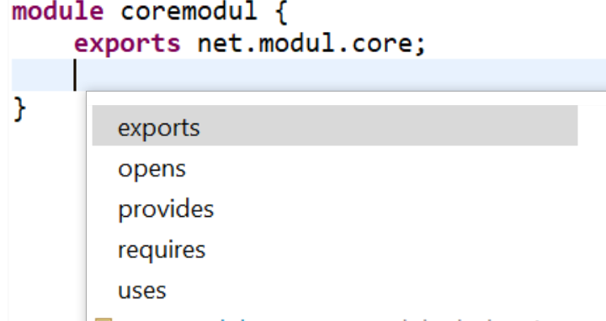
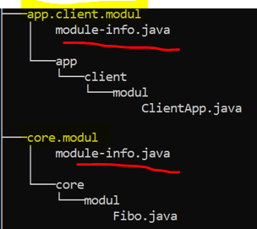
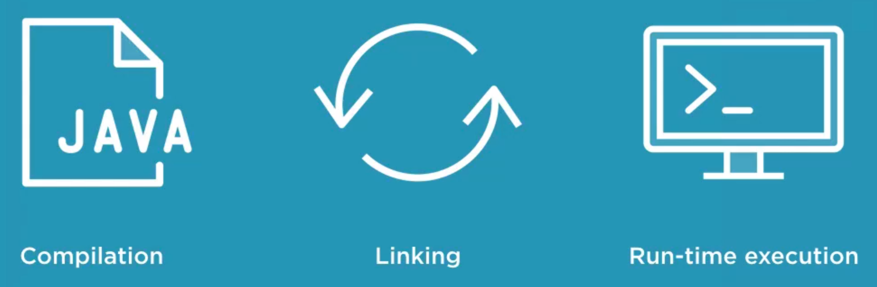
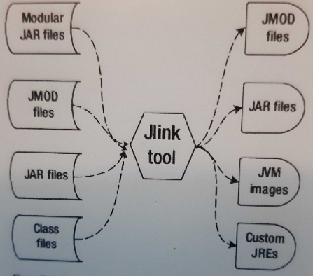
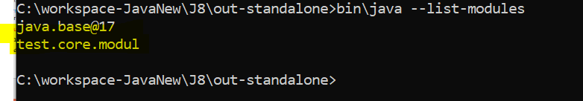
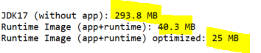
Module contains: one module (cannot have sub-module/s), has unique module name, packages,
types, native code (if module has JMOD format), resources and one module descriptor //module-info.java – contains module meta-data
Creating Modules
A module descriptor describes a named module and defines methods to obtain each of its components. Modules export packages (API Interface) and require other modules (explicit dependency). Not listed means (hidden) strong encapsulation.
Modules can be distributed one of two ways: as a JAR file or as an “exploded” compiled project.
Format: jmod, jar. Jmod – contains native libs. etc… when shipping module with native code.
Creating Runtime IMAGES
Packing a Java Module as a Standalone Application
It is common to only have one Java module per project.
Using jlink tool you can package a Java module along with only required modules (recursively) and the Java Runtime Environment into a standalone application. No Java pre-installation needed to run the application, Java is included in pack. Very small, fast and portable. Compact(cutom) runtime image you can deploy to cloud…, or make docker images. (classic way: still some java image+app.)
//inspect module definitions
C:\workspace-JavaNew\Java-Features>java --describe-module java.sql
java.sql@17-ea
exports java.sql //package name
exports javax.sql
requires java.transaction.xa transitive
requires java.base mandated
requires java.logging transitive
requires java.xml transitive //module name
uses java.sql.Driver
> jlink --module-path "out;C:\apps\Java\jdk-17\jmods" --add-modules test.core.modul --output out-standalone
Also can be optimized: --strip-debug --compress 0|1|2
> cd C:\workspace-JavaNew\J8\out-standalone
echo "Running the image"
bin\java --module test.core.modul/test.core.modul.Fibo
> bin\java -–list-modules ;)
Notes:
We have to be careful though because we can only have one module per JAR file. You can not have one jar with multiple MODULES.
Startup time is getting slower if size gets smaller, ….
A module is a named set of Java packages, resources, and native libraries
What is Module Meta Data?
As we discussed in the previous section, we can use Module Descriptor to provide Module Meta Data. A Module has the following Meta Data:
A unique name.
exports clause.
requires clause.
Are “module”, “requires”, and “exports” Keywords? They are just “Contextual Keywords” only. That means they are keywords only with a Module Descriptor (“module-info.java”) file.
The requires directive introduces three new concepts: Reliable configuration, Readability, Accessibility
a
Java 9 uses MODULEPATH instead of CLASSPATH. Of course, Java 9 supports both MODULEPATH and CLASSPATH.
--strip-debug is enabled by default in the build for JRE images, and reduces size of the runtime image (lib/modules) by ~20% (130M -> 106M) with no effect on startup
--compress=0 drops the size of lib/modules by ~30% (106M -> 69.5M), and actually seems to benefit startup in simple tests (~8 ms improvement on Hello World).
--compress=1 drops the size of lib/modules by ~54% (106M -> 49M), but comes with a penalty to startup (~8ms slowdown on Hello World)
--compress=2 drops the size of lib/modules by ~53% (106M -> 49.5M), but comes with an even greater penalty to startup (~13ms slowdown on Hello World)
In my opinion the numeric level argument to --compress is counter-intuitive and should perhaps be called out explicitly instead (--compress=strings, --compress=zip). Since it appears the two different compression strategies are working against each other it seems that perhaps they should even be mutually exclusive (remove --compress=2).
--compress=0 strikes a balance between improving startup and static footprint, --compress=1 minimizes static footprint at a small penalty to startup time.
Creating runtime images
rm –rf jars && mkdir –p jars
jar –create –file jars/easy.analys.api.jar –C out/easy.analys.api .
jar –create –file jars/easy.analys.cli.jar --main-class=easy.analys.Main -C out/easy.analys.api .
----
Rm –rf image && jlink –module-path jars/:JAVA_HOME/jmods –add-modules abc
-- strip-debug
--compress=2
--output image
Module Versioning
http://tutorials.jenkov.com/java/modules.html#compiling-a-java-module
Services (focuses on limits of encapsulation)
The service interface module only exports the Java package that contains the service interface. The service interface is just a normal Java interface.
Service Implementation Module: A module that wants to implement a service interface from a service interface
Service Providers, service registers, service loaders, uses … provides, .
Requires Static (maven like. E.g. compile time, if server hast that lib. Or tests, .. )
Sometimes we write code that references another module, but that users of our library will never want to use.
For instance, we might write a utility function that pretty-prints our internal state when another logging module is present. But, not every consumer of our library will want this functionality, and they don't want to include an extra logging library.
In these cases, we want to use an optional dependency. By using the requires static directive, we create a compile-time-only dependency:
module my.module { requires static module.name; }
Requires Transitive
We commonly work with libraries to make our lives easier.
But, we need to make sure that any module that brings in our code will also bring in these extra ‘transitive' dependencies or they won't work.
Luckily, we can use the requires transitive directive to force any downstream consumers also to read our required dependencies:
module my.module { requires transitive module.name; }Now, when a developer requires my.module, they won't also have also to say requires module.name for our module to still work.
Exports … To
We can use exports…to to open up our public classes to the world.
But, what if we don't want the entire world to access our API?
We can restrict which modules have access to our APIs using the exports…to directive.
Similar to the exports directive, we declare a package as exported. But, we also list which modules we are allowing to import this package as a requires. Let's see what this looks like:
module my.module { export com.my.package.name to com.specific.package; }
Uses
A service is an implementation of a specific interface or abstract class that can be consumed by other classes.
Provides … With
A module can also be a service provider that other modules can consume.
The first part of the directive is the provides keyword. Here is where we put the interface or abstract class name.
Next, we have the with directive where we provide the implementation class name that either implements the interface or extends the abstract class.
Open
We mentioned earlier that encapsulation was a driving motivator for the design of this module system.
Before Java 9, it was possible to use reflection to examine every type and member in a package, even the private ones. Nothing was truly encapsulated, which can open up all kinds of problems for developers of the libraries.
Because Java 9 enforces strong encapsulation, we now have to explicitly grant permission for other modules to reflect on our classes.
If we want to continue to allow full reflection as older versions of Java did, we can simply open the entire module up:
open module my.module { }
Command Line Options
By now, support for Java 9 modules has been added to Maven and Gradle, so you won't need to do a lot of manual building of your projects. However, it's still valuable to know how to use the module system from the command line.
We'll be using the command line for our full example down below to help solidify how the entire system works in our minds.
module-path – We use the –module-path option to specify the module path. This is a list of one or more directories that contain your modules.
add-reads – Instead of relying on the module declaration file, we can use the command line equivalent of the requires directive; –add-reads.
add-exports – Command line replacement for the exports directive.
add-opens – Replace the open clause in the module declaration file.
add-modules – Adds the list of modules into the default set of modules
list-modules – Prints a list of all modules and their version strings
patch-module – Add or override classes in a modules
illegal-access=permit|warn|deny – Either relax strong encapsulation by showing a single global warning, shows every warning, or fails with errors. The default is permit.

Slide 11
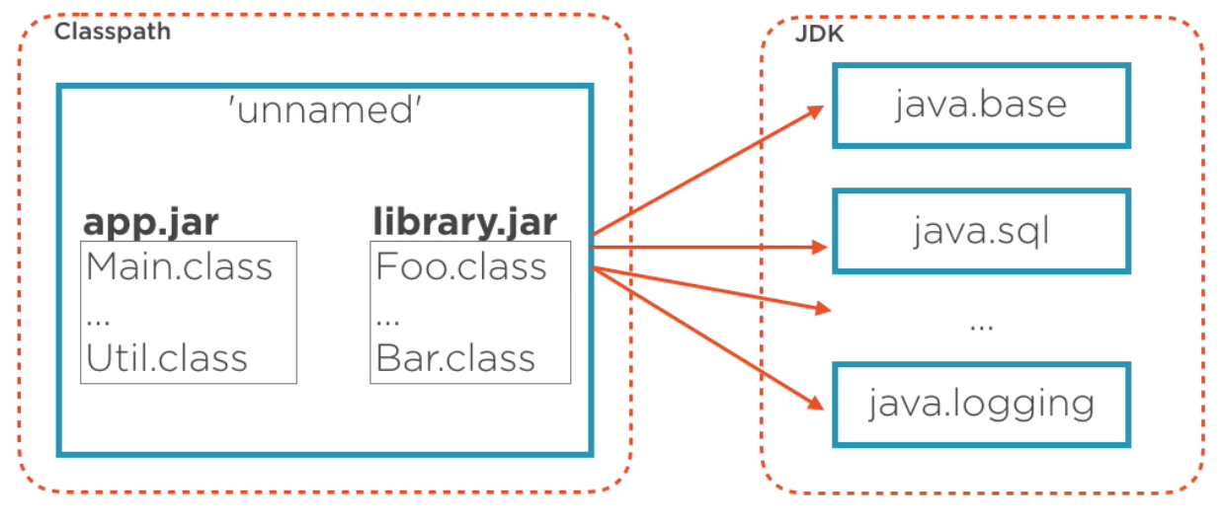
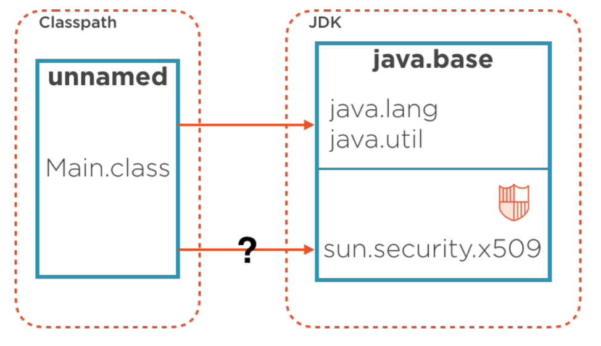
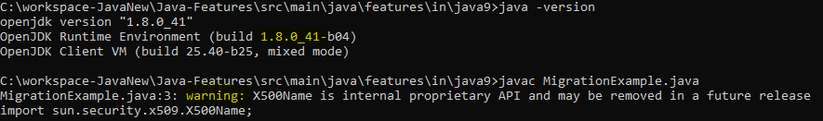
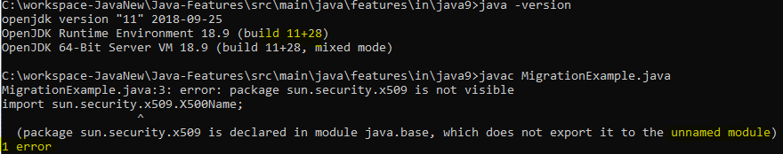
Migrating Classpath based apps to Module based (modulepath) - Concerns
JAVA 8 → 9 (that easy?) > javac -cp $CLASSPATH, java -cp $CLASSPATH
using module system is optional (unnamed module, automatic m.), can keep using classpath.
The unnamed module can read all named modules, automatic or non-automatic.
//unless use JDK types 1. encapsulated, 2. non-default java modules. 3. Cyclic, etc.
Automatic module - add any library’s JAR file to an app’s module path, it becomes automatic
1. Using encapsulated types
import sun.security.x509.X500Name;
public class MigrationExample { public static void main(String[] args) { X500Name nem = new X500Name("CN=user"); }}
//apps still allowed to use encapsulated types in JDK for backward comp.
//Runs on Java 8, but strong encapsulation make it fail in Java 9
If you want to focus on future create modular applications
Code must use public APIs instead of encapsulated internal APIs, use tool jdeps
- Run app with:> –illegal-access=deny [permit /default] so this is future-proof [not for future, has strong encapsulation, note that =permit may be removed in future]
If you don’t want to change the code
> javac --add-exports java.base/sun.security.x509=ALL-UNNAMED MigrationExample.java
MigrationExample.java:3: warning: X500Name is internal proprietary API and may be removed in a future release
import sun.security.x509.X500Name;
> java --add-exports java.base/sun.security.x509=ALL-UNNAMED MigrationExample
jdeps –jdkinternals MigrationExample.class
Notes:
Code must use public APIs instead of encapsulated internal APIs, use tool jdeps
- Run app with:> –illegal-access=deny [permit /default] so this is future-proof [not for future, has strong encapsulation, note that =permit may be removed in future]
Module TYPES (Unnamed, System, Application, Automatic )
https://developer.ibm.com/tutorials/java-modularity-5/
$MAJOR.$MINOR.$SECURITY.$PATCH
UN-NAMED Module
A class that is not a member of a named module is a member of a special module known as the unnamed module.
The unnamed module concept is like the unnamed package (the default package).
The unnamed module does not have module-info.java, or in other words, the classes that do not have modules are promoted to the unnamed module.
The unnamed module is not a real module. It is like a default module that does not have a name.
All classes compiled in older versions of the language that are not yet migrated to modules (or will never be) belong to the unnamed module when running in the Java 9+ environment.
The unnamed module requires every other named module automatically. That means all classes within the unnamed module can read all another named or unnamed modules without an explicit declaration of any kind
That also means that older classes written prior to Java 9 can read all modules defined by the new module system, so all such classes will continue to compile and run in Java SE 9 without any modification.
The packages exported by the unnamed module can only be read by another unnamed module. It is not possible that a named module can read (requires) the unnamed module.
Once your CLASSPATH based app is migrated to Java 9, there is no MODULE (no explicit dependencies),
Do we need to create a module descriptor (module-info.java)? Luckily NO -→
When migrating CLASSPATH APP to Java 9
When CLASSes loaed MODULE is constructed with UN-NAMED name. So unnamed module is created.
Unnamed-module is a very special module under JVM. It automatically gets dependencies to the modules in the modular JDK.
Remember: PUBLIC (exported part), PRIVATE (encapsulated part).
In Java 9 you can still use the -classpath argument to the Java VM when running an application.
On the classpath you can include all your older Java classes, just like you have done before Java 9.
All classes found on the classpath will be included in what Java calls the unnamed module.
The unnamed module exports all its packages. However, the classes in the unnamed module are only readable by other classes in the unnamed module - or from automatic modules (see next section). No named module can read the classes of the unnamed module.
The solution is called automatic modules. An automatic module is made from a JAR file with Java classes that are not modularized, meaning the JAR file has no module descriptor.
This is the case with JAR files developed with Java 8 or earlier. When you place an ordinary JAR file on the module path (not the classpath) the Java VM will convert it to an automatic module at runtime.
Say you have a modular application called app (containing the module-info.class) that wants to use a third-party non-modular JAR file called lib.jar (that does not have the module-info.class). If you run the main class com.app.Main.class using the following commandthen lib.jar automatically becomes modular for app:
java --module-path appClasses;lib --module app/com.app.Main
Adding Modules to the Unnamed Module
The unnamed module concept is similar to the default package. Therefore, it's not considered a real module, but can be viewed as the default module.
If a class is not a member of a named module, then it will be automatically considered as part of this unnamed module.
Sometimes, to ensure specific platform, library, or service-provider modules in the module graph, we need to add modules to the default root set. For example, when we try to run Java 8 programs as-is with Java 9 compiler we may need to add modules.
In general, the option to add the named modules to the default set of root modules is –add-modules <module>(,<module>)* where <module> is a module name.
For example, to provide access to all java.xml.bind modules the syntax would be:
--add-modules java.xml.bindTo use this in Maven, we can embed the same to the maven-compiler-plugin:
<plugin> <groupId>org.apache.maven.plugins</groupId> <artifactId>maven-compiler-plugin</artifactId> <version>3.8.0</version> <configuration> <source>9</source> <target>9</target> <compilerArgs> <arg>--add-modules</arg> <arg>java.xml.bind</arg> </compilerArgs> </configuration> </plugin>

Slide 12
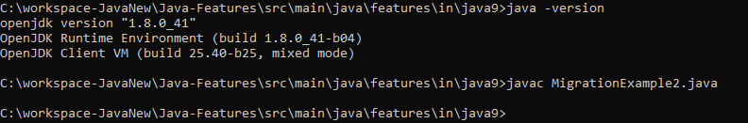
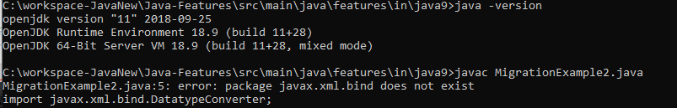
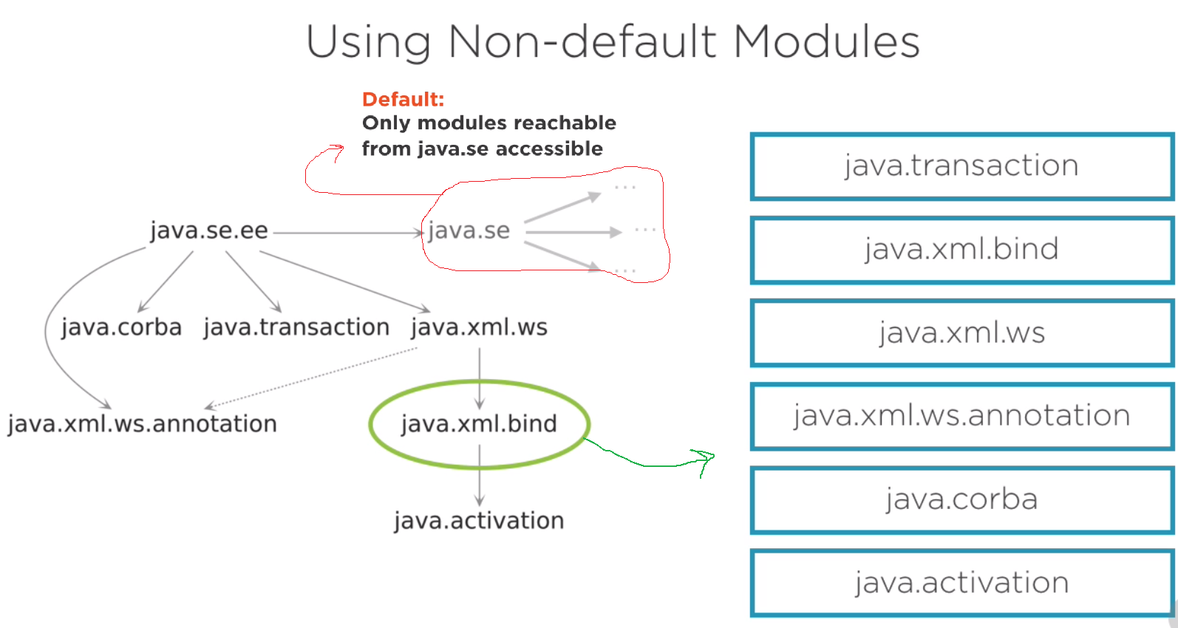
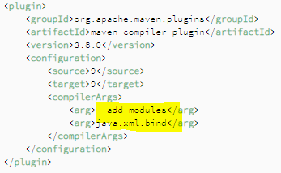
Migrating Classpath based apps to Module based (modulepath) - Concerns
2. Using non-default Java SE modules
import javax.xml.bind.DatatypeConverter;
public class MigrationExample2 {
public static void main(String[] args) throws IOException {
DatatypeConverter.parseBase64Binary("EWsaRS43dshfJUir"); }}
//not reachable, because those libs are app-server specific
implementations, and even removed now, solution:
javac --add-modules java.xml.bind MigrationExample2.java
java --add-modules java.xml.bind MigrationExample2
java --add-modules java.se.ee MigrationExample2
jdeps MigrationExample2.class
C:\workspace-JavaNew\Java-Features\src\main\java\features\in\java9>jdeps MigrationExample2.class
Notes:
UN-NAMED Module
Once your CLASSPATH based app is migrated to Java 9, there is no MODULE (no explicit dependencies),
Do we need to create a module descriptor (module-info.java)? Luckily NO -→
When migrating CLASSPATH APP to Java 9
When CLASSes loaed MODULE is constructed with UN-NAMED name. So unnamed module is created.
Unnamed-module is a very special module under JVM. It automatically gets dependencies to the moduls in the modular JDK.
Remember: PUBLIC (exported part), PRIVATE (encapsulated part)

Slide 13
Using New Tools in JDK 9
jdeprscan - used to scan usage of deprecated APIs in jar file, classpath, or src-dir.
>jdeprscan.exe --class-path . ProcessApiImprovements_JEP102
class features/in/java9/ProcessApiImprovements_JEP102 uses deprecated method java/awt/List::addItem(Ljava/lang/String;)V
jdeps - analysis your code base (by path to the .class file, dir, jar) list package-wise dependencies and modules. Helpful to migrate to modular-app.
C:\workspace-JavaNew\Java-Features\src\main\java\features\in\java9>jdeps .
jlink - used to select modules and create a smaller runtime image with the selected modules. jlink – Java Linker
>jlink --module-path mods/:%JAVA_HOME/jmods --add-modules comp-packt --output img
jmod - is a new format for packaging your modules. This format allows including native-code, config-files, and other data that do not fit into jar-file.
The Java modules are packaged as JMOD files. jmod command-line allows create/list/describe/hash JMOD files.
>jmod ..
jjs - -- removed in Java 15 (….)
Diagnostic tools: Jcmd, jinfo, jps, jmap, jstack, jstat, https://visualvm.github.io
jshell - JEP 222: Jshell (REPL – Read, Eval, Print, Loop) similar to NodeJS, List, Groovy, Scala has. Easily, quickly test new ideas, new features, review API, small POC. Just on CMD. No need to write java class, compile,run. Support code completion (TAB-TAB), analyze, build-in doc. Auto exception-handling on checked ones, but you can do it explicitly.
jshell> "aaaz c".matches("[a]+z\sc")
/help /vars /imports /methods /types /save myCode.jsh, /open myCode.jsh , /open MyDemo.java >jshell –-class-path …
/set feedback verbose
>jshell --class-path commons-lang3-3.12.0.jar jshell> import org.apache.commons.lang3.StringUtils
jshell> StringUtils.leftPad("Broadcom", 33)
Jshell can be used as an API for (code completion, source code analysis, ..) IDEs can use it,. Or Jshell js = Jshell.create(); js.eval..
https://docs.oracle.com/javase/8/docs/platform/jvmti/jvmti.html
Notes:
Jdeps – is a ststic class dependency analyzer and is used to analyze the static dependencies of the application and its libraries

Slide 14
New Features in JAVA 9
Language/library Improvements
Collection Factory Methods
OLD ways: E.g. OldWayOfCreationOrConversion (Java), Apache, Guava, ..
List<Integer> integers = Arrays.asList(2, 4, 1, 3, 8, 4, 7, 5, 9, 6, 8);
List<String> ooo = new ArrayList<>() {{ add("try workaround1 ");add("try workaround2 "); }};
Collections.singletonList(new String("ds")); Collections.emptyList(); Collections.unmodifiableList, …. Stream.of(Java8)
Factory Methods Java 9 (immutable collection) – list, set, map, …
List.of(), List.of(E e1), List.of(E e1, E e2), .. Upto 10 elements.
Also static <E> List<E> of(E... elements) { //intermediate arr. allocation
List.of(1).getClass -> java.util.ImmutableCollections$List1, 2, 3, N
Map.of(K key1, V val1) upto 10 pair, Map.ofEntries(Map.Entry<K, V> … entries) //unbounded
Iteration order for Maps and Sets here not guaranteed, use List for guaranteed order
Notes:
VAR args internally implemented as arrays.
List.of(E… elements) – intermediate array allocation
So, only for 10 elements added, so no array allocation happens there, no intermediate allocation happens

Slide 15
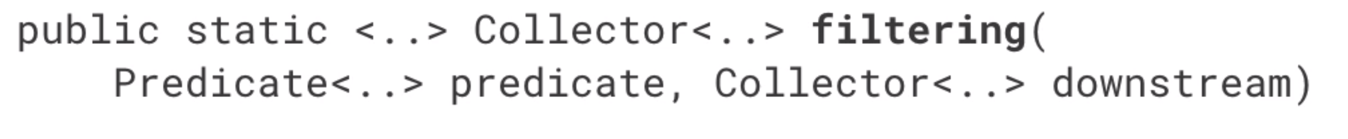
New Features in JAVA 9
Language/library Improvements
Stream API Improvements
List<String> ll = getList();
Stream<String> stream = ll == null ? Stream.empty(): ll.stream();
int count = Stream.ofNullable(ll).count(); System.out.println(count); //0
//or Apache CollectionUtils
Apache - collections4.CollectionUtils.emptyIfNull(list).stream()
//Java8 Optional.ofNullable
stream = Optional.ofNullable(ll).orElse(List.of()).stream();
Stream.of("a", "b", "c", " ", "d", "", "z").takeWhile(s -> !s.isEmpty()).forEach(System.out::print); //abc d
Stream.of("a", "b", "c", " ", "d", "", "z").dropWhile(s -> !s.isEmpty()).forEach(System.out::print);//z
Stream.of("a", "b", "c", " ", "d", "", "z").takeWhile(s -> !s.isBlank()).forEach(System.out::print);//abc
Stream.of("a", "b", "c", " ", "d", "", " ", "z").dropWhile(s -> !s.isBlank()).forEach(System.out::print);// d z
IntStream.iterate(0, x -> x < 100, i -> i + 4).forEach(System.out::print);
//04812162024
Map<Integer, List<Integer>> ints = Stream.of(11,22,33,63) .collect(groupingBy(i -> i % 2,toList()));
// {0=[22], 1=[11, 33, 63]}
Map<Double, Set<String>> byPriceMap = winners.collect(
groupingBy(Fifa::getPrice, flatMapping(b -> b.getWinner().stream(), toSet())
)
);
//prevent NullPointerExceptions
Static: Stream.ofNullable() (before check and use Stream.empty())
Stream.iterate()[hasNext predicate prm]
takeWhile()[while true], dropWhile()[drops until true]
New Collectors
Advanced collector: Collectors
.groupingBy, //like SQL query case
Two new: .filtering, .flatMapping
Notes:
Map<Integer, List<Integer>> ints =
Stream.of(1,2,3,3)
.collect(groupingBy(i -> i % 2,
toList()));
Collectors are consuming stream and put it into new one.
So collectors materializes stream into new collection

Slide 16
New Features in JAVA 9
Language/library Improvements
of(), empty()
//transform
Optional<String> s = Optional.of(“Ola");
s.map(String::toUpperCase); // “OLA“
Optional<Integer> i = Optional.empty();
i.map(n -> n + 1); // still empty, NPE?
Optional.stream()
Interoperability between Optional and Stream
List<Optional<String>> list = Arrays.asList(Optional.empty(), Optional.of("A"), Optional.empty(), Optional.of("B"));
List<String> filteredListJava9 = list.stream()
.flatMap(Optional::stream).collect(Collectors.toList()); //[A, B]
optional.ifPresentOrElse(x -> System.out.println("Value: " + x), () -> System.out.println("Not Present.")); //[A, B]
Optional<String> optional1 = Optional.of("Rimini"); Supplier<Optional<String>> supplierString = () -> Optional.of("Not Present"); optional1 = optional1.or(supplierString); optional1.ifPresent(x -> System.out.println("Value: " + x));//Value: Rimini
Optional Improvements
ifPresentOrElse(), or(), stream()
//transform
Optional<String> s = Optional.of(“Ola");
s.map(String::toUpperCase); // “OLA“
Optional<Integer> i = Optional.empty();
i.map(n -> n + 1); // still empty, NPE?
Notes:
Before Optional we used to return NULL ;)
still empty, no NPE

Slide 17
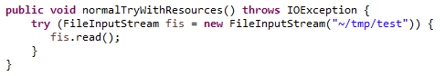
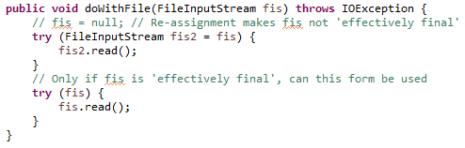
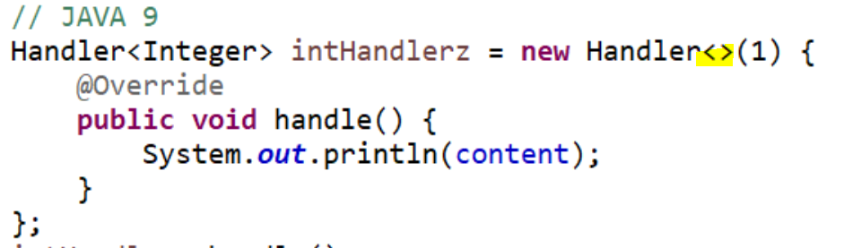
New Features in JAVA 9
Small Language Changes
JEP 213 – Milling Project Coin
Private methods in Java Interface
Underscore as identifier illegal: String _ = "underscore"; //as of release 9, '_' is a keyword
Possible future use: list.forEach( _ -> doSomething())
Improved try-with-resources
//Direct instantiation, previous Java version. //in practice you already have f.i.s. And want to use it in try(), in Java 9 OK
//Before Java 9, you have to declare it //condition is fis must be effectively FINAL
Better generic type inference for anonymous classes
Java compiler improved to support this
Localization: Unicode 8.0, java.locale.providers=COMPAT,CLDR
Java Time: Duration#dvidedBy(),truncatedTo(), Clockn#systemUTC(), Locale#datesUntil()
Notes:
effective final is: declared and defined before but never re-assigned during program-execution
Either has final keyword, or not re-assigned, … . No assignment
You can not use diamond operator for anonymous classes before Java 9.
But normal List<Integer> I = new ArrayList<>(); was possible from Java 7-8

Slide 18
New Features in JAVA 9
Other Improvements
NEW Java9 Javadoc HTML5 way (html output, search, modules)
Old-api: https://docs.oracle.com/javase/8/docs/api/ >javadoc -d C:/JAVA_doc_new -html5 _IntroJava9.java
New-api: https://docs.oracle.com/javase/9/docs/api/overview-summary.html
Localization
Unicode 8.0: 10000+ new characters, Properties-files: ISO-8859-1 to UTF-8
Common Locale Data Repository (JDK now reach locale data from standard cldr formats)
If you want old way, use: java.locale.providers=COMPAT, CLDR, …
java.time since Java 8
Added methods: Duration#dividedBy(), truncatedTo(), Clock#systemUTC() //most precise, nano
LocalDate#datesUntil()
@Deprecated(forRemoval = true, since = "9")
e.g java.lang.Object#finalize, avax.net.ssl.HandshakeCompletedEvent#getPeerCertificateChain
Notes:
Default encoding for properties files are now UTF-8.
If charactes ASCII no impact, other case look compatibility.
Localization formats, CLDR, before it was from COMPAT, …. So you get Java 8
Before Clock#systemUTC() // is used System.currentTimesMillis

Slide 19
New Features in JAVA 9
Language and Library Improvements New APIs
JEP 238 Multirelease: Allows developers to build jars with diff. version of class files for diff. Java ver.
javac --release 7 JRelease7.java
javac --release 9 JRelease9.java
JEP 102: ProcessHandle – Improves Process Handling
Process represents native process created by Java, ProcessHandle represents any process on OS
Process#toHandle, ProcessHandle.of(123), ProcessHandle.Info //list processes, and more info like task mgr. in OS
Long.parseLong(ManagementFactory.getRuntimeMXBean().getName().split("@")[0]); //process id before Java 8
ProcessHandle.current().pid(); //process id by Java 9
JEP 110: HTTP/2 Client (incubator in Java 9, default in Java 11) – replacement for HTTPURLConnection, supports http/2
JEP 266 (more concurrency update): java.util.concurrent.Flow, Flow API: Publisher, Subscription, Subscriber
Reactive Streams – stream data support for backpressure. Interfaces to impl. pub-sub: RxJava, AKKA Streams, Spring 5
StackWalker (new API to support navigating the stack trace, more helpful than just printing stack trace)
Before: StackTraceElement[] stackTrace = new Throwable().getStackTrace(); //or stackTrace = Thread.getStackTrace();
Low performance, No guarantee all stack elements are returned, No partial handling possible
Java 9: StackWalker, StackFrame. StackWalker walker = StackWalker.getInstance(); walker.forEach(System.out::println);
Notes:
Still like HTTP 1.1 a. request, response based, b. GET/POS/DELETE, … methods
Difference: HTTP 2.0 – a. Binary protocol, Mandatory TLS, Multiplexing over single TCP conn. (streams), Server push capability

Slide 20
New Features in JAVA 9
Desktop Enhancements
Java Browser Plugin Removed
Deprecated: java.applet.Applet (use Java Web Start as a fallback solution ), or JS handles all solution now.
Extended HiDPI support, Graphics Improvements – GTK+3 support on Linux
Marlin Renderer (OpenJDK 9) better than Oracle Ductus, OpenJDK Pisces
New API for taskbar interaction
Platform Specific Desktop Features:
java.awt.Desktop new methods
java.awt.desktop new package with interfaces: Callback types for events and handlers
java.awt.Taskbar manipulate taskbar icon, show progress, manage context menu.. isSupported()
Multi Resolution Images: Represent same image at different resolutions
JavaFX Modularized: jfxrt.jar (splitted into modules) – Control, Skin, Behavior. Java FX is most modern GUI
JavaFX new APIs: java.fx.scene.control.skin, javafx.css
Platform Specific Desktop Features:
Notes:
java.awt.Taskbar
Allow the image I/O plugin to support the TIFF image format

Slide 21
New Features in JAVA 9
JVM Performance Improvements
GC Deprectaions
GC combinations deprecated in Java 8 removed
CMS (Concurrent Mark Sweep) garbage collector is depreciated. Use: -XX:+UseConcMarkSweepGC
G1 – Garbage First garbage collector (introduced in Java 6, now became default in Java 9, replaces CMS)
Generational Garbage Collection (issue is tuning, long pause “STOP THE WORLD”) [Heap regions: Eden, Survivor, Tenured ]
G1 Garbage Collector [Heap divided multiple: Eden, Survivor, Tenured regions, as matrix ]
G1 is incremental, Parallel marking, Designed for large heaps, a bit more CPU intensive, Low pauses, tunable pause goal
Automatically tunes: Heap region size, Parallel threads, pause time interval
Short and faster memory management with: -XX:MaxGCPauseMillis=200 //tune pause goals
Trade some throughput for lower latency: -XX:+G1EnableStringDeduplication //performance optimization
Notes:
-XX:+G1EnableStringDeduplication
G1 – focuses on reducing the pause times of garbage collection activity. These pause times are very critical to latency critical applications and hence, such applications are going towards adopting the new garbage collector

Slide 22
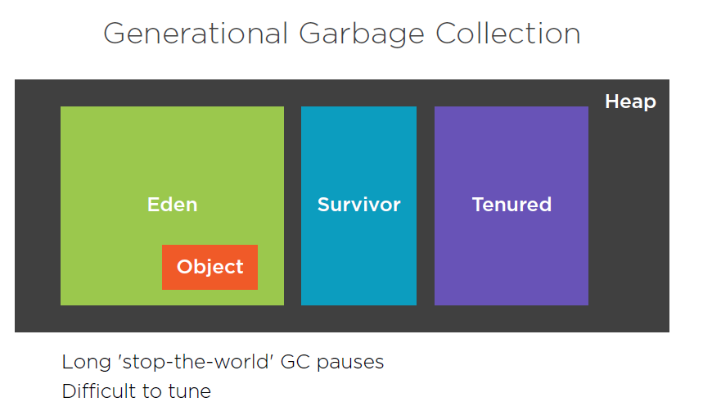
Notes:
https://app.pluralsight.com/course-player?clipId=35a8f669-c00f-4907-bbde-ec5ca676d178
Long enough lived objects moved to Eden -> Survivor -> Tenured.
Objects in Tenured regions, are much more STABLE. This fact makes GC treats differently in all regions.
GC needs to happen more in Eden than Survivor, and so on.
Simply most objects die (short lived objects GC ted) in Eden. Main problem is: long PAUSE:
Whole VM pauses until GC happens.
So this is GENRATIONAL GC

Slide 23
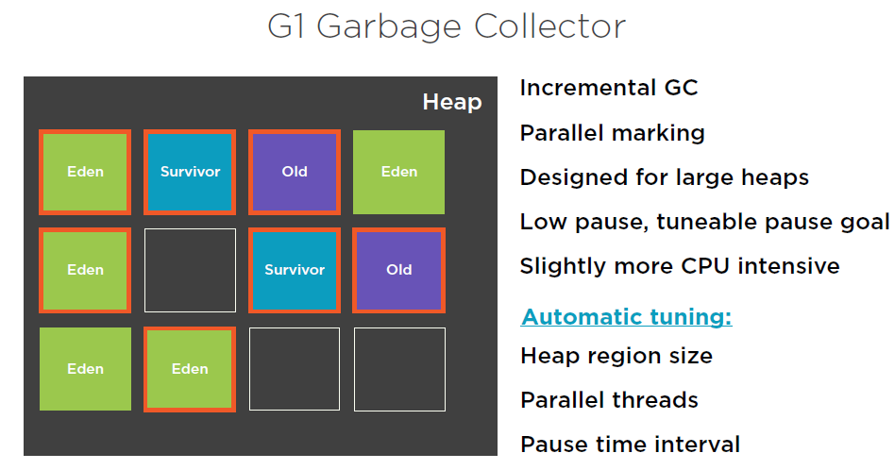
Notes:
Instead of 3 regions, in G1 collector, region divided into many regions, like matrix.
Eden region, still keeps STOP the WORLD. BUT G1 can decide just several Eden regions, should be garbage collected – scanned.
So less STOP WORLD happens. That is why INCREMENTAL.
Also, Surviv0r and Tenured regions can be in parallel GC ed, but application still can RUN.
G1 never scans whole at once. Works on subset of regions. Low pause time and tuneable
Low pause time BUT more CPU intensive, ..
Be careful with PAUSE TIMES.

Slide 24
New Features in JAVA 9
String Performance Improvements
Compact Strings: Lower memory usage, effective immediately without code changes.
Pre: char[], utf-16 (each char 2 bytes), but for ascii text single byte is enough. Java9: byte[], and byte coderFlag
String concatenation changes: Change concatenation translation strategy, Groundwork for future improvements
String s = "a" + "b" + "c"; before via StringBuilder#append … recompile ..
Java 9: invokedynamic bytecode, late binding (at runtime), stable byte code, open to future enhancement.
Danger of Serialization
ObjectOutputStream, ObjectInputStream -> Vulnerabilities, embedded ..
New interface – filter data before Serialization: ObjectInputFilter[UNDECIDED,ALLOWED,REJECTED]
Per stream: ObjectInputStream::setObjectInputFilter, for all streams: ObjectInputFilter.Config.setSerialFilter
Or use ‘jdk.serialFilter’ system property. maxbytes,maxarray, maxdepth = n
So if your app uses serialization, this is the fastest way to secure it, ..
Security Improvements
TLS improvements (https): ALPN (Application Layer Protocol Negotiation) Select ALPN during Handshake
Required for http/2 support, httpclient uses it
Java 9 supports DTLS (Datagram Transport Layer Security) 1.0/1.2 aligned with TLS 1.1 and 1.2 via SSLEngine and DatagramSocket
OCSP (Online Certificate state Protocol) Stapling: check for x.509 certificate revocation when establishing TLS connections
SHA-1 Certificate is disabled now, SHA-3 support is added instead. Java 9 rejects certificates signed by SHA-1
Notes:
Help to prevent DoC attack, denial service attack.
Someone can send large deserialized files/obj …. So tune/limit it with ‘jdk.serialFilter’ system property. maxbytes,maxarray, maxdepth = n
Or filter by TYPES, or backages, .. Net.sahet.*, or !net.test.*
So no need additional implementation for security, …
Changing the internal representations of String, to make use of byte-array rather than character-array. In character arrays, each element is 2 bytes, and it was observed that majority of
Strings use 1 byte. It was causing wasteful allocation (memory ). The new representation would also introduce a flag to indicate the type of encoding used.
UNDECIDED,ALLOWED,REJECTED;
}
}
ObjectInputStream::setObjectInputFilter per stream, ObjectInputFilter.Config.setSerialFilter for all streams
With ALPN - Application Layer Protocol Negationship and Handshaking are merged, and done as one step.

Slide 25
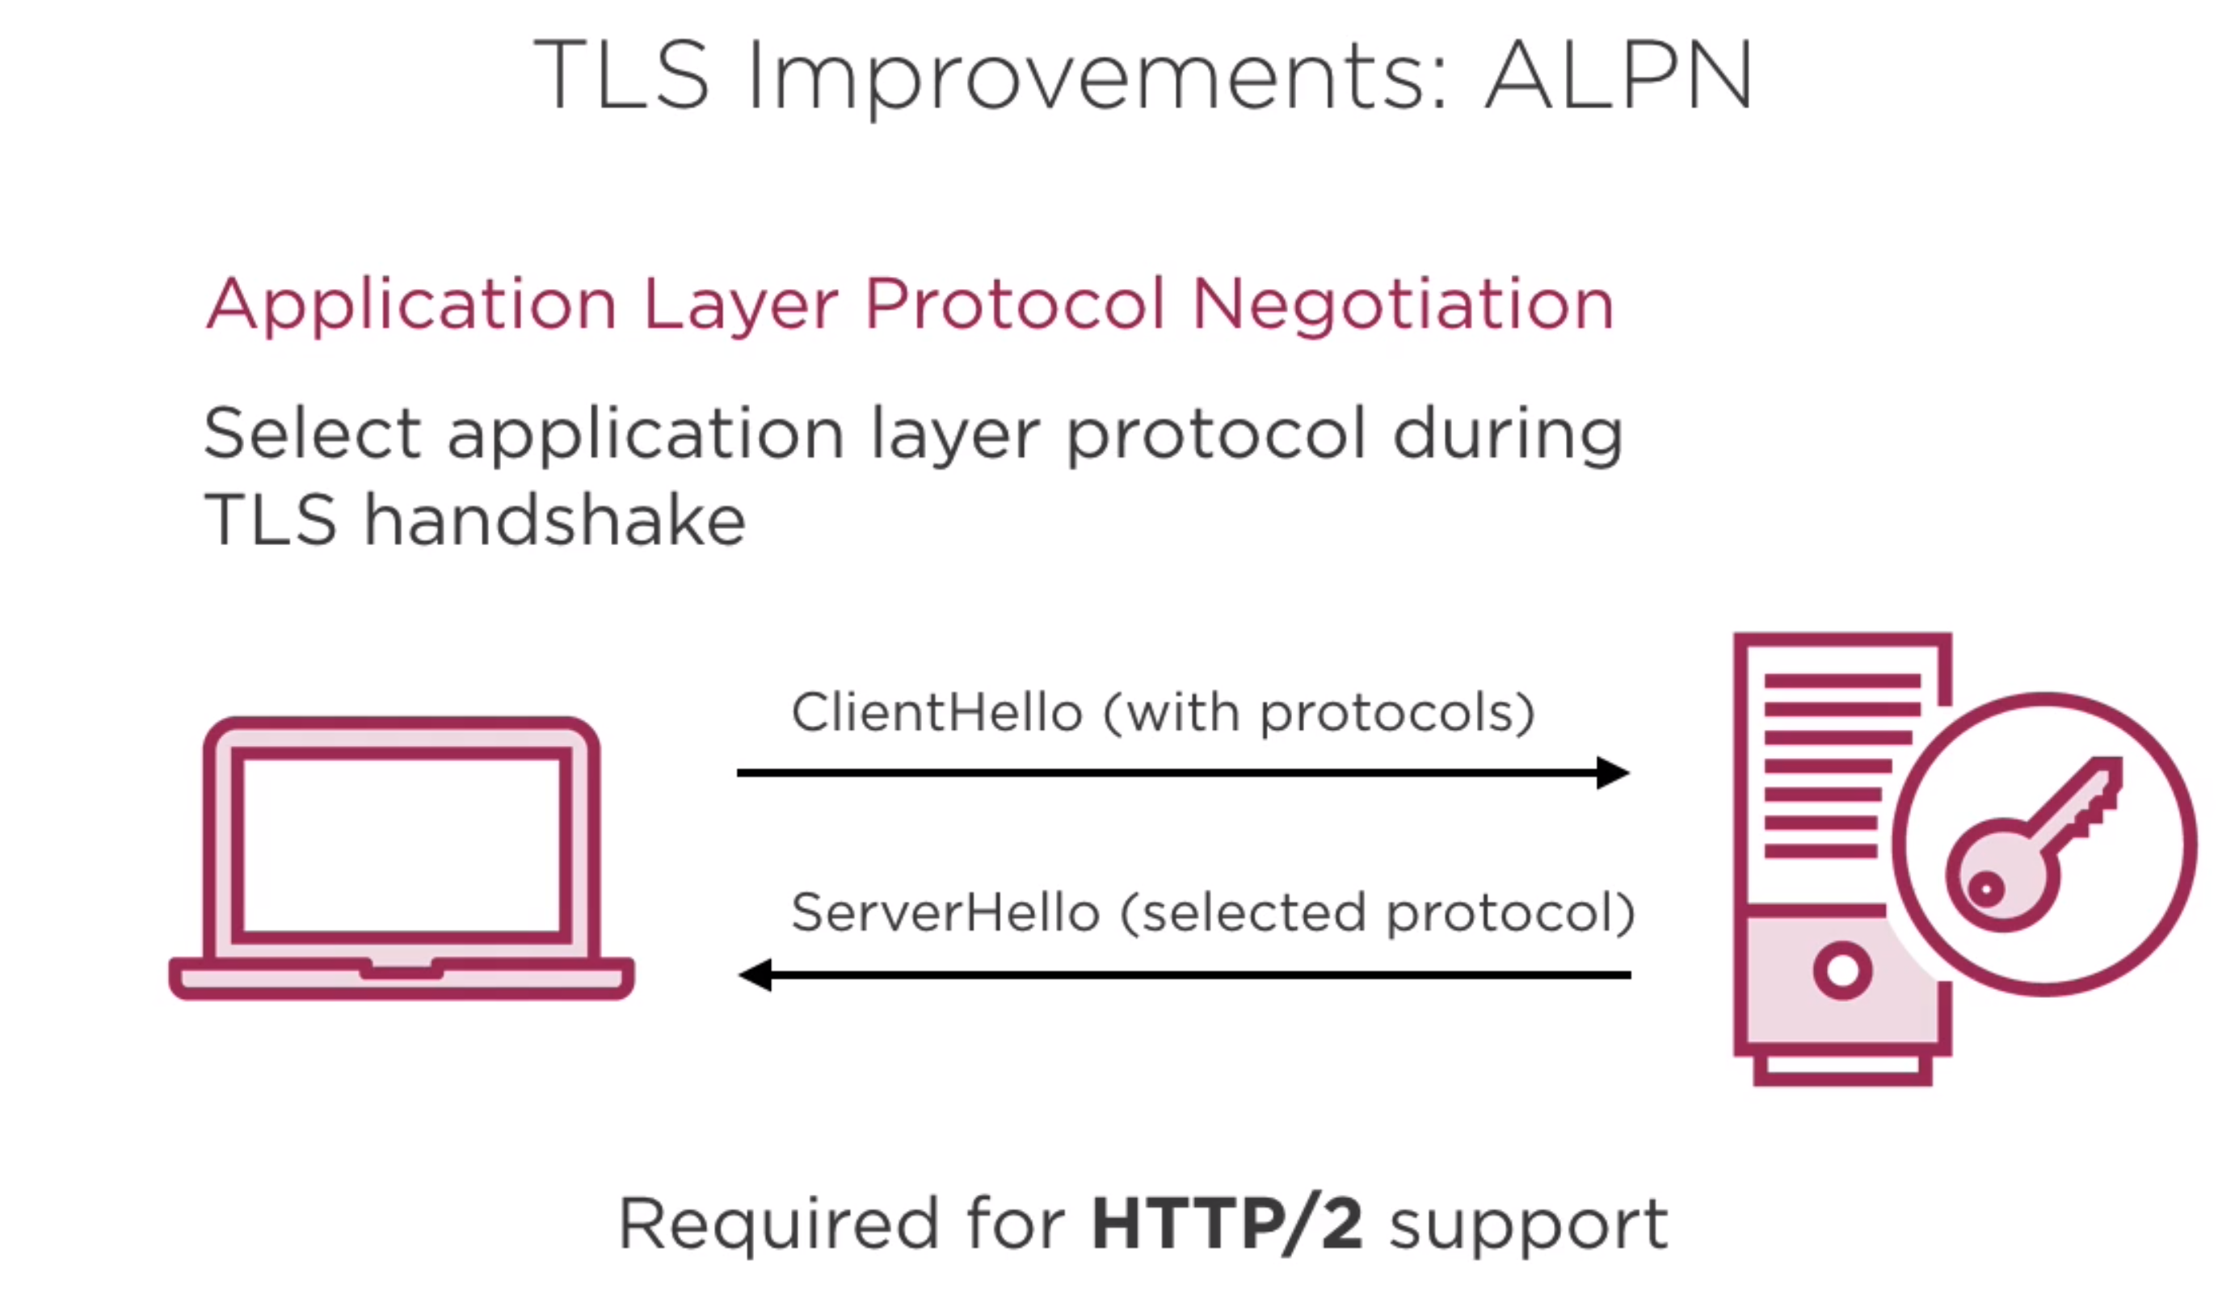

Slide 26
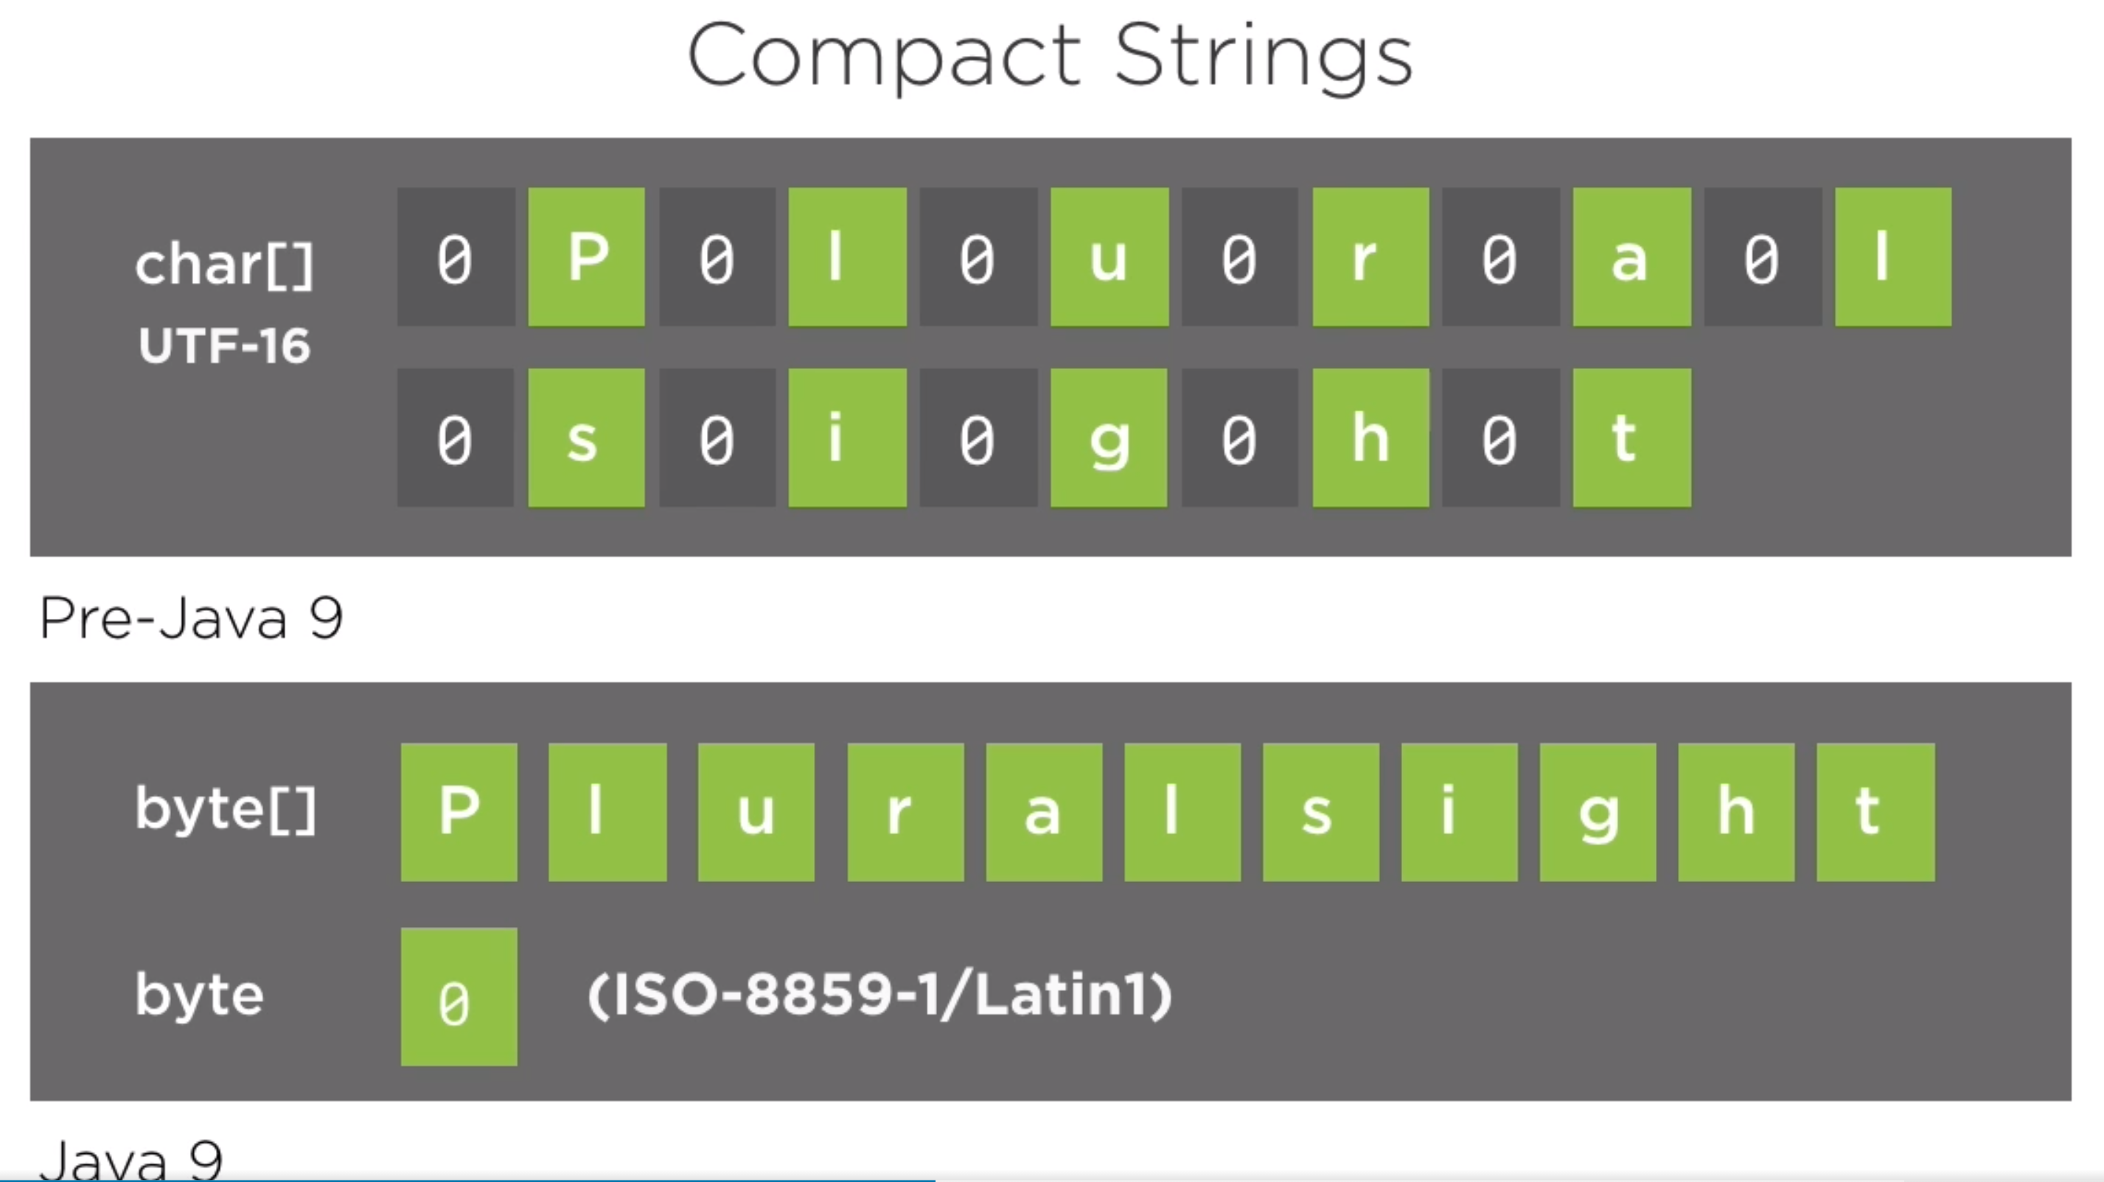
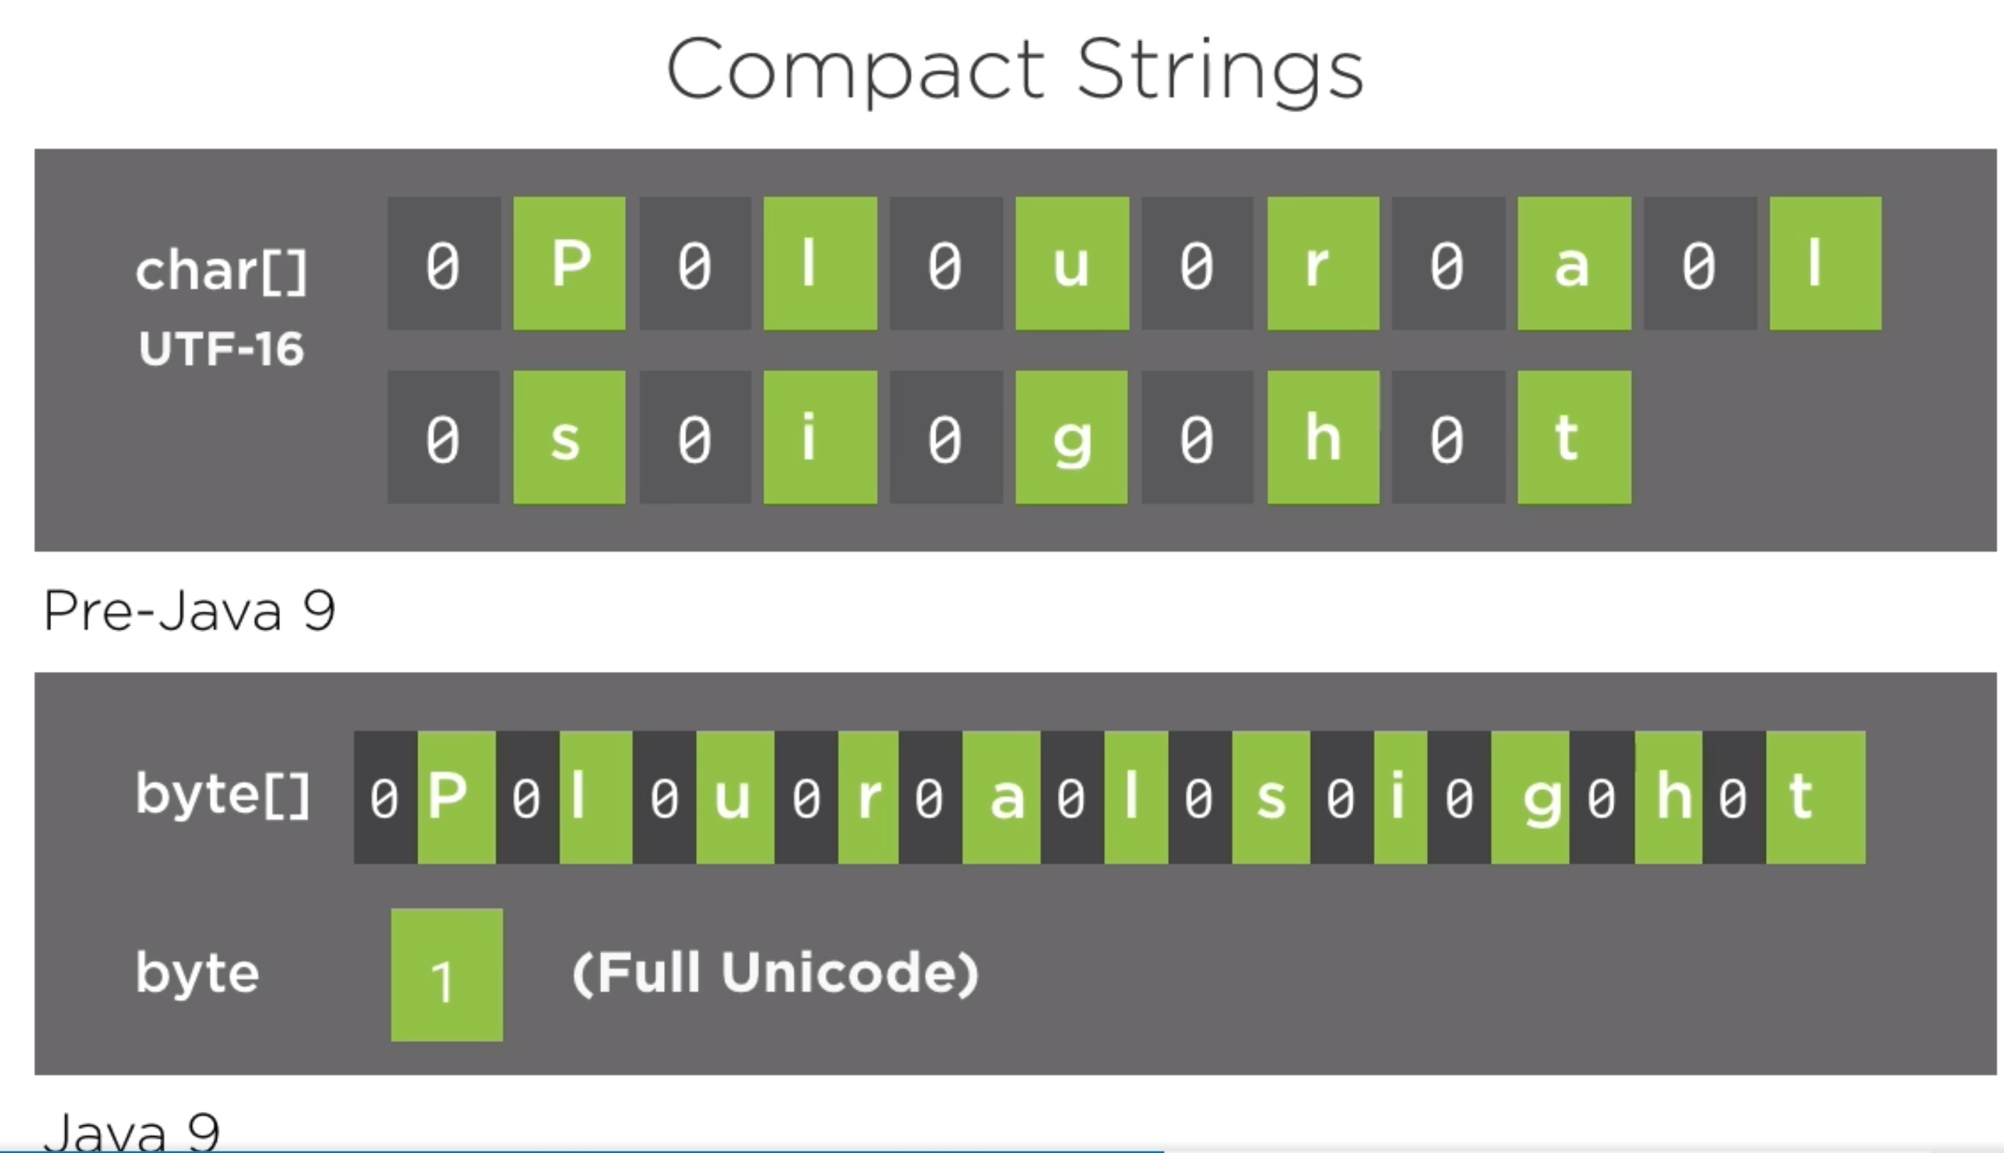

Slide 27
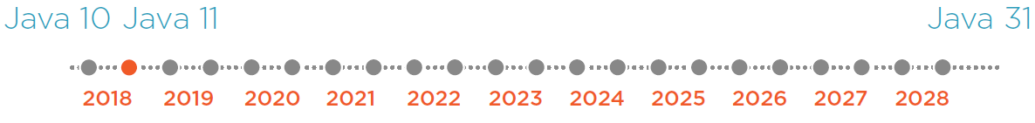
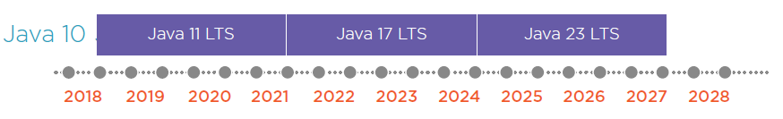
New Features in JAVA 10
JAVA 10 – Last free version of JDK
I further propose to aim explicitly for a regular two-year release cycle going forward. Mark R. 2012, Project Jigsaw: Late for the train
“I propose that after Java 9 we adopt a strict, time-based model with a new feature release every six months.” Mark R. 2017
From “Big feature-driven” release to “Time-based” model
New JAVA Release Schedule
Since Java SE 10, in every 6 months there is a new release. Keeps small and incremental. Not all releases will be the Long-Term-Support (LTS) releases, LTS will happen only in every 3 years. Current LTS version of Java is 11, next one is Java 17. Non-LTS release are not experimental (standard releases with new possible features or improvements) releases.
Convergence Oracle JDK and Open JDK (commercial features will be moved to Open JDK e.g. [ACDS, Flight Recorder(telemetry), Mission Control, Z-GC] Oracle JDK will be commercially supported build of Open JDK code base). Deprecations and removals in JDK 10. 1) Binary build by Oracle only for WinOS|Linux|MacOS|(no more ARM), 64-bit only, GPL 2 license. Azul(+32 bit+ARM devices), IBM, AdoptOpenJDK has their own BUILDs.
2) Security and Certificates: With Java 10, Oracle has open-sourced the root certificates. Oracle's Root CA program to be ported to OpenJDK.
What about the support? Via LTS
Impact of Frequent Release cycle?
- Tool vendors, libraries, frameworks adoption
- Releases are small and incremental (can shift)
- Non LST releases are standard release
Deprecations, removals between LTS release, may impact (once migration, 3 years of tech. depth) if you only adopt LTS release. Better differentiate “prod” and “test/dev” environment. Even easier to track with Java Docker images. And, also via –release Java 9 multi-release flag we can keep going, …
Notes:
With Java 10, Oracle has open-sourced the root certificates. Oracle's Root CA program to be ported to OpenJDK.
Security and Certificates: OpenJDK has no some certificates under “cacerts”, because more authorities signed agreement with Oracle not with OpenJDK. So Oracle is moving this Root CA program to Open JDK. But still some parties are not signed agreemend yet, so process will take some time.
E.g. With SYmDUMP I saw this security issues, once downloading MAVEN architypes
Frequent delays, e.g. several times postponed Jigsaw which included finally in Java 9
Oracle JDK build based on Open JDK. Plus some rendering engine, alternative GC implementations, …
So starting from JDK 9 Oracle started CONVERGENCE process. So GOLA is BUILD should be IDENTICAL for both.
All Java 7,8,9 are released late than planned date. So, in every 2 year even not sufficient.
To say on supported version, then challenging, so Oracle introduced LTS – Java 11, 17, 23, ..
E.g. Junit or some other libraries, only works on Java 8, or 11, … such issues
What about support? – We want to use supported version, so we can get security/performance updates.
“In order to increase the predictability of all future Java SE releases, I further propose to aim explicitly for a regular two-year release cycle going forward.” Mark Reinhold, 2012
“I propose that after Java 9 we adopt a strict, time-based model with a new feature release every six months.” Mark Reinhold, 2017
Mark Reinhold Architect, Alex Buckley
https://www.oracle.com/java/technologies/java-se-support-roadmap.html

Slide 28
New Features in JAVA 10
Features
286: Local-Variable Type Inference 296: Consolidate the JDK Forest into a Single Repository 304: Garbage-Collector Interface 307: Parallel Full GC for G1 310: Application Class-Data Sharing 312: Thread-Local Handshakes 313: Remove the Native-Header Generation Tool (javah) 314: Additional Unicode Language-Tag Extensions 316: Heap Allocation on Alternative Memory Devices 317: Experimental Java-Based JIT Compiler 319: Root Certificates 322: Time-Based Release Versioning
Source code: https://github.com/azatsatklichov/Java-Features/tree/master/src/main/java/features/in/java10
Notes:
https://mkyong.com/java/what-is-new-in-java-16/#jep-392-packaging-tool

Slide 29
New Features in JAVA 10
Root certificate - cacerts:
With Java 10, Oracle has open-sourced the root certificates. Oracle's Root CA program to be ported to OpenJDK.
See all public certificates :) > cd C:\apps\Java\jdk-14\lib\security > keytool -list -keystore cacerts > * changeit
Deprecations and removals
javah command-line-tool is removed. Use alternative: javac -h <dir>
Policytool is removed. Even simple text editors can be used to create/edit policy files in case need
Removed command-line tools/options: -X:prof -> If you want profiling info, use jmap tool, or 3rd party profilers
Deprecated APIs (keep in mind during migration):
java.security.acl -> java.security.
In java.security package types {Certificate,Identity,IdentityScope,Signer} are deprecated
javax.security.auth.Policy -> java.security.Policy
Local-variable (var is not a keyword, also using var is compiled time inferred by RHS rule, no runtime overhead)
Local-variable Type Inference [already Java7 <> LHS, or lambdas] like C#, Scala, Kotlin. Also Lombok has “var”, “val” as like
- Focus on variable names (readability), less code, vertical alignments (cursor ;). Driving the meaning of variable.
var not makes Java dynamic. Just during compilation helps us, inferred by compiler only.
There are rules, how to use when to use “var”. Not handy to use all the time (not make someone to GUESS TYPE).
Not use var with lambda combination. Not use var with diamond operator. Not use on chained-methods.
Non denotable types: Null, Anonymous class instances, Intersection types (Comparable & Serializable)
var empty = null; //NO. var obj = new Object(){} //Object$1 extends Object
var ls = List.of(1, “2”, 4.67); //List<? extends Comparable & Serializable <..>> //NO
Notes:
LOCAL VAR only. So you can not use for method-variables, try-vatch, etc. Not because of technically impossible.
Just because of, language get more confusing, not-readable.
You can not use VAR with LAMBDA combinations, …
(readability, code read many times but written once)
VAR is not a KEYWORD. To make KEYWORD is a BIG change. You can not use it as an IDENTIFIER.
var is not a keyword, just a reserved type name, e.g. var var = “var”;)

Slide 30
New Features in JAVA 10
JVM Performance Improvements
G1GC: look Java 9. In Java 9 G1GC is serial full GC
Java 10, G1GC became parallel full GC: -XX:ParallelGCThreads
Application Class Data Sharing – ACDS (later in Java 12 improved)
Improve VM start-up time (useful also running same code or repeated execution with multiple VMs )
System Class Data Sharing: classes.jsa (saves upto 10-30% startup time)
Application Class Data Sharing: myApp.jsa, need a extracted class list first: -XX:DumpLoadedClassList=myApp.lst
Improved Docker Container Awareness: Query container instead of host OS
Optional class improvement:
orElseThrow - java.util.Optional, java.util.OptionalDouble, java.util.OptionalInt and java.util.OptionalLong each got a new method orElseThrow()
Unmodifiable Collectors:
Unmodifiable collections – copyOf() on List, Set, Map and
Collectors.toUnmodifiableList()
OptionalInt opInt = OptionalInt.of(12345); System.out.println("int Value via " + " orElseThrow() = " + opInt.orElseThrow());//NoSuchElementException
//existing one
IntStream.of(1, 2, 3).average(//).orElseThrow(() -> new IllegalArgumentException("Array is empty"));
//MAP.put(entry.getKey(), ImmutableSet.copyOf(entry.getValue()));
MAP.put(entry.getKey(), Set.copyOf(entry.getValue()));
List<Integer> evenList = ints.stream()
.filter(i -> i % 2 == 0).collect(Collectors.toUnmodifiableList());
evenList.add(4);// UnsupportedOperationException
Notes:
Improved Container Awareness

Slide 31
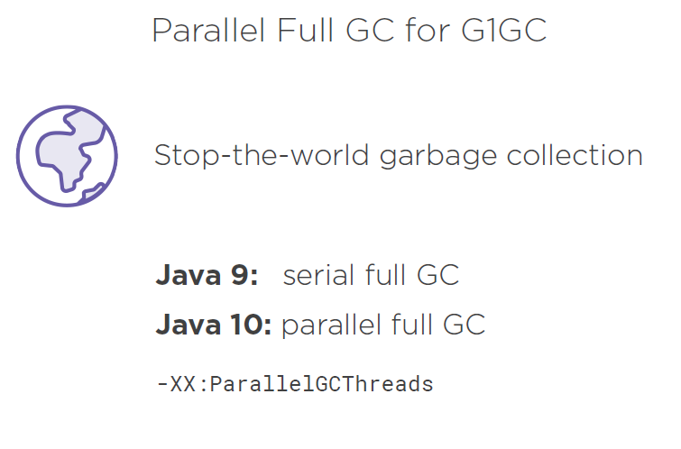

Slide 32
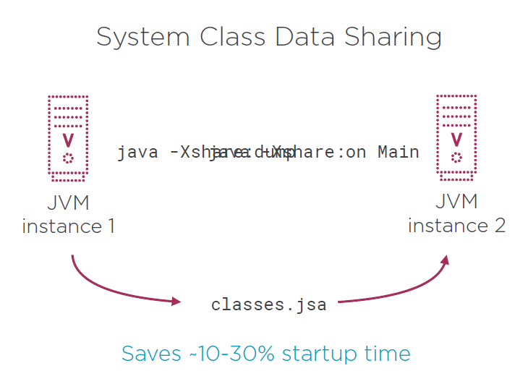

Slide 33
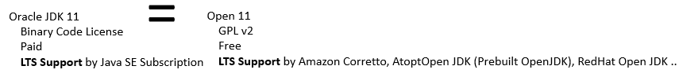
New Features in JAVA 11
First LTS Release (Only by Oracle) after Java 8(2019), next Java 17
See slide: JAVA 8 and Beyond
Since version 11, Oracle contributes (starting from Java 9) some commercial features to OpenJDK community. Oracle JDK “commercial features” such as Flight Recorder, Java Mission Control, and Application Class-Data Sharing, as well as the Z Garbage Collector, and also Oracle has open-sourced the root certificates in Java 10, are now available in OpenJDK. Therefore, Oracle JDK and OpenJDK builds are essentially identical from Java 11 onward. There is no real technical difference between the two since the build process for the Oracle JDK is based on that of OpenJDK. OpenJDK, in contrast, will deliver releases more often.
What about the support? Via LTS (only Oracle and AdoptOpenJDK offers LTS )
Other vendors (Open JDK, RedHat, Azul) has support just for 6 mo. inc. Java 11, 17, … So no difference to keep Java 10 or 11 on Open JDK from support point of view.
Goal: convergence of Oracle & OpenJDK codebases – DONE, removed: -XX:+UnlockCommercialFeatures
Difference is on licensing. Oracle has Oracle Binary Code License Agreement whereas OpenJDK has GPL 2. Both were free upon Java 10.
WoooW LTS 2 years – from Java 2017 - https://www.oracle.com/emea/news/announcement/oracle-releases-java-17-2021-09-14/
Notes:
(readability, code read many times but written once)
You could buy support for Java from Oracle. Now it is changing with Java 11.
You can not use Oracle JDK in production, as free of charge. They introduces “Subscription” model to use in production with support.
If you want to run Java in production without paying to Oracle, use Open JDK. They are technically same.

Slide 34
New Features in JAVA 11
Features
181: Nest-Based Access Control 309: Dynamic Class-File Constants 315: Improve Aarch64 Intrinsics 318: Epsilon: A No-Op Garbage Collector 320: Remove the Java EE and CORBA Modules 321: HTTP Client (Standard) 323: Local-Variable Syntax for Lambda Parameters 324: Key Agreement with Curve25519 and Curve448 327: Unicode 10 328: Flight Recorder 329: ChaCha20 and Poly1305 Cryptographic Algorithms 330: Launch Single-File Source-Code Programs 331: Low-Overhead Heap Profiling 332: Transport Layer Security (TLS) 1.3 333: ZGC: A Scalable Low-Latency Garbage Collector (Experimental) 335: Deprecate the Nashorn JavaScript Engine 336: Deprecate the Pack200 Tools and API
Source code: https://github.com/azatsatklichov/Java-Features/tree/master/src/main/java/features/in/java11
Notes:
https://mkyong.com/java/what-is-new-in-java-16/#jep-392-packaging-tool

Slide 35
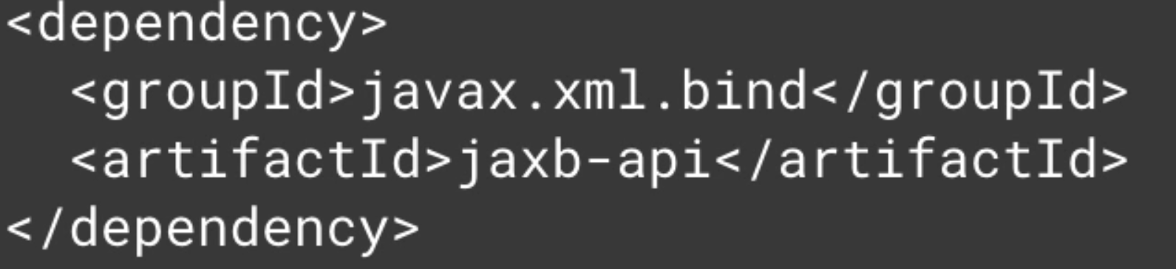
Deprecations and removed Technologies in JAVA 11
read more client-roadmap, roadmap-update
Applets removed: Only Java 8 Commercial Support left
Java Web Start removed: Alternatives use tools jlint or jpackager?
Deprecate the Pack200 Tools and API
Nashorn deprecated (in Java 15 will be removed): Alternatives Graal.js, or Project Detroit (Google V8) – aims to be the base for a native implementation of javax.script package based on the Open Source JavaScript engine V8.
GraalVM provides an ECMAScript-compliant runtime to execute JavaScript and Node.js applications.
Removed enterprise API - java.xml.*, bind(JAXB), ws(JAX-WS), ws.annotation, java.corba(CORBA), java.transaction(JTA), Java Beans Activation, wsgen, wsimport, schemagen, xjc, idlj, orbd, servertool, tnamesrv,
Alternatives: use related maven dependencies (most of them are now Apache projects, or in App-Server Runtime)
Removed methods: Thread#destroy(),stop(Throwable obj), java.lang.System::runFinalizersOnExit, ava.lang.Runtime::runFinalizersOnExit, SecurityManager 4 methods #checkAwtEventQueueAccess, and etc.
Instead of all these 4 methods you can use checkPermission(java.security.Permission)
JavaFX – no longer part of JDK, alternative: use OpenJFX project
(javafx-base, javafx-controls, javafx-media). After removing JavaFX from Java SE,
Javapackager (used to create native[MSI/DMG] installers) is also removed.
<dependency>
<groupId>org.openjfx</groupId>
<artifactId>javafx</artifactId>
<version>11-ea+19</version>
</dependency>
Notes:
javafx-base, javafx-controls, javafx-media
This JEP deprecates the pack200 and unpack200 tools, and the Pack200 API in java.util.jar package, and it will probably remove in the future release.
Jpackager is also may alternate JavaPackager
Applets removed – no need vulnerable browser plugins browser. Java Web Start – enabling to start Java Desktop app in browser.
Nashhorn – main reason to removal is maintaining cost for two runtime. Because JS is so changing, ..
Applets no alternative – just migrate your app to real web-application.
No alternative to Java Web Start. But you can apply standalone app to create runtime image.

Slide 36

New Features in JAVA 11
Scripting - Run Shebang #!
//java --source 11 single-shebang-incmd
b. //On Win tric: use Cygwin or git-bash
> ./single-shebang-file
Launching Single-file
OLD approach: 1. >java Hello.java 2. >java Hello
Since Java 11 (single file): > java Hello.java
Language and Library Improvements, Additions
HttpClient (was incubator in Java 9) – replacement for HTTPURLConnection, supports http/2, WebSockets
Reactive Streams – stream data support for backpressure, Flow API. Base Interface for RxJava, AKKA Streams, Spring 5
Flow API: Publisher, Subscription, Subscriber
ProcessHandle.current().destroyForcibly(); //java.lang.IllegalStateException: destroy of current process not allowed
String - new methods: Unicode aware repeat(), isBlank(), strip(), lines
Files – new methods: readString(), writeString() , encoded by UTF-8, ..
Optional::isEmpty, e.g. var opt = Optional.ofNullable(null); opt.isEmpty() == true
Predicate::not e.g. List.of(“AB”, “”, “sasa”).stream().filter(Predicate.not(String::isBlank)).forEach(System.out::println);
Upgraded from Unicode 8 to 10: 16000 more chars, 10 new scripts, e.g. \u20BF for BitCoin
Local var type inference for Lambda params: (String a, String b) -> a.concat(b) as: (a, b) -> a.concat(b) or
e.g. (var a, var b) -> a.concat(b), (@Nonnull var a, @Nullable var b) -> a.concat(b)
Limitations (no mix): (var a, b) -> a.concat(b), (var a, String b) -> a.concat(b), var a -> a.toUpperCase()
Notes:
Since Java 11: > java Hello.java
JVM sees you pass SOURCE instead of CLASS file to “java” command, and internally compile SOURCE file and RUN the file.
But this feature is limited to single SRC file, no external dependency via setting classpath will work.
Just use --source to define Java level. This enables US to create SCRIPTS to use in SHEBANG
This allows to create EXECUTABE SCRIPTS written in JAVA

Slide 37
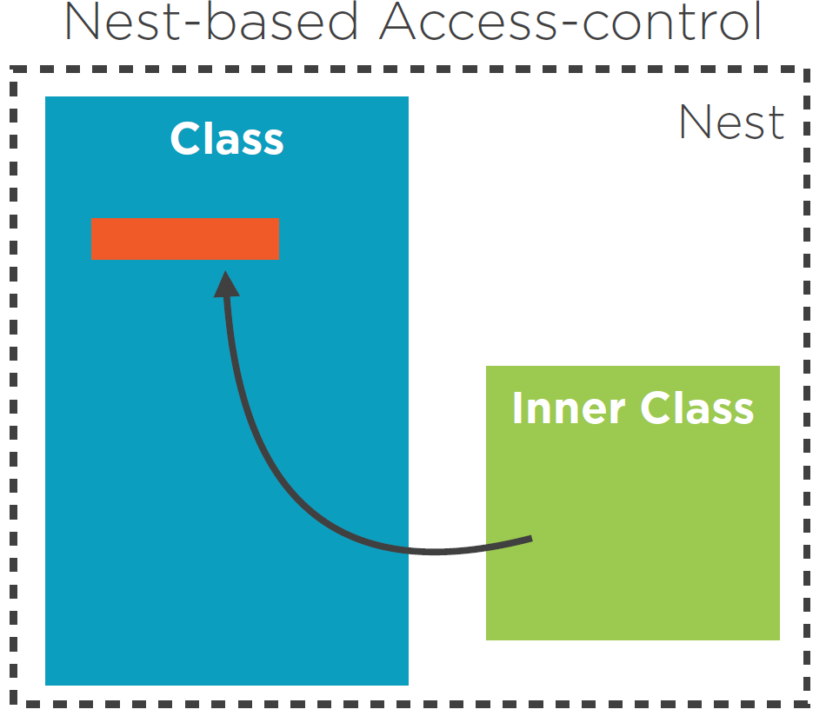
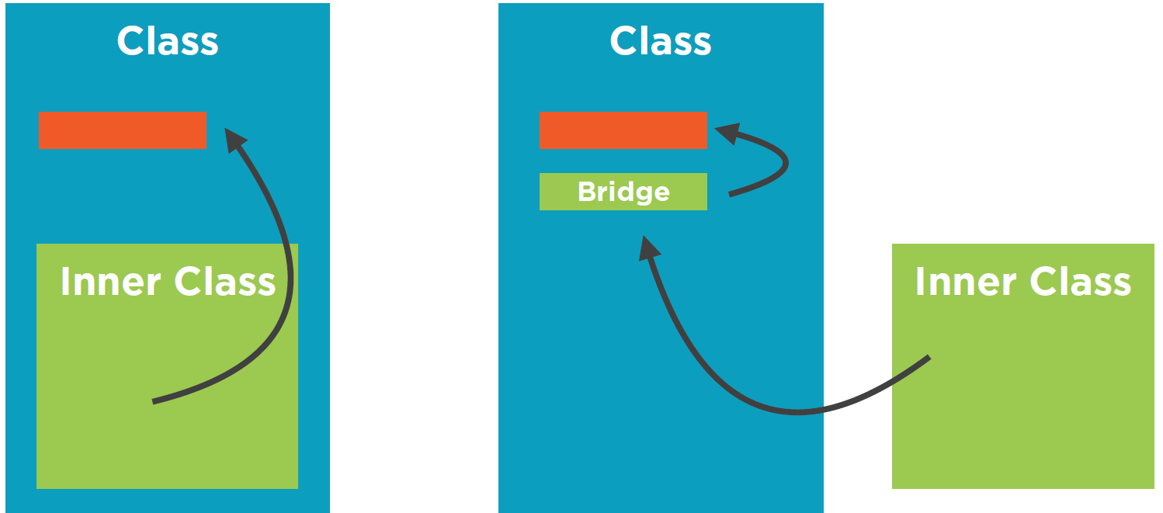
New Features in JAVA 11
With Nest-Based Access Control mechanism inner class can access it directly in Nested manner. Compiler no need to create bridge-method. Inner classes can access it. This mechanism also used in Sealed classes in Later Java.
Nest Based Access
Outer Java class which has Inner class at Runtime inner class access private fields of Outer class via Bridge method. Compiler creates this synthetic bridge method. But once developer uses reflection to call private method, it fails at runtime.
B
A
JVM Change
Dynamic Class-file Constants
Extends class-file format to support a new constant-pool form, CONSTANT_Dynamic, target language designers and compiler implementors. Loading a CONSTANT_Dynamic will delegate creation to a bootstrap method, just as linking an invokedynamic call site delegates linkage to a bootstrap method.
Improve Aarch64 Intrinsics
Optimized the existing string and array intrinsics, and implements new intrinsics for Math.sin(), Math.cos() and Match.log() on Arm64 or Aarch64 processors. it means better performance. P.S An intrinsic is used to leverage CPU architecture-specific assembly code to improve the performance.
Notes:
Reflection mechanism does not know anything about bridge-methods.
So this addresses by Nested classes.
Optimized the existing string and array intrinsics, and implements new intrinsics for Math.sin(), Math.cos() and Match.log() on Arm64 or Aarch64 processors. it means better performance.
P.S An intrinsic is used to leverage CPU architecture-specific assembly code to improve the performance.
It supports private access within nest members directly, no more via an auto-generated bridge method access$000. Furthermore, new nested APIs for validation and allowed private reflection access within nest members.
If we compile the above class, it will generate two classes, Alphabet and Alphabet$A, even a nested class is a typical class with a unique name. The JVM access rule will not allow private access within different classes. However, Java allowed private access within nest members, so the Java compiler creates a bridge method access$000 to apply on the JVM access rule.
n Java 11, The Java compiler will not generate any bridge method access$000 for private access within nest members. This new JVM access rule, Nest-Based Access Control allowed private access within nest members.

Slide 38
Performance and Security Improvements
G1GC: G1 – Garbage First garbage collector (introduced in Java 6, default since Java 9 several incremental improvements up to Java 11)
Epsilon GC (experimental) - A No-Op GC. Apps with predictable, bounded memory usage, performance[stress] testing, short-lived obj. Allocates memory but not collect any garbage (memory allocation), once the Java heap is exhausted, the JVM will shut down. Params: -XX:+UnlockExperimentalVMOptions, -XX:+UseEpsilonGC
ZGC - A Scalable Low-Latency Z Garbage Collector (Experimental) [pause time under 10 ms, maybe in future 1 ms]
No pause time increase with heap size increase, Scale to multi-terabyte heaps. Colored Pointers Linux/x64 only: -XX:+UnlockExperimentalVMOptions, -XX:+UseZGC .
Yes ZGC provides a short pause times when cleaning up heap memories. However, it didn’t return unused heap memory to the operating system, this improved in Java 13. Added support for Win in Java 14, and became prod-feature in Java 15
331: Low-Overhead Heap Profiling: Provide a low-overhead way of sampling Java heap allocations, accessible via JVMTI
TLS 1.3 – Only HTTPS, all handshake messages except first encrypted. Elliptic curve algorithm is used. Key Agreement with Curve25519 and Curve448
TLS 1.3 is not fully implemented yet, cipher mismatches, DSA certificate not used DTLS 1.3 not implemented yet.
ChaCha20 and Poly1305 Cryptographic Algorithms
Notes:
A new No-Op (no operations) Garbage Collector, it allocates memory but will not collect any garbage (memory allocation), once the Java heap is exhausted, the JVM will shut down.
A few use cases:
Performance testing
VM interface testing
Short-lived jobs
This GC is an experimental feature; we need to use the following options to enable the new Epsilon GC.
and Curve448
Java Virtual Machine Tool Interface (JVMTI) was introduced in J2SE 5, JDK 5 (Tiger), it provides APIs for profiling or monitoring tools to access the JVM state. This JEP added new low overhead heap profiling API into the JVMIT.
The Z Garbage Collector (ZGC) is an experimental garbage collector; it has low pause times not exceed 10ms. This ZCG support only on Linux/64.
In Java 14, this ZCG extends support on macOS JEP 364 and Windows JEP 365.
This ZGC garbage collector is a product feature in Java 15 JEP 377.

Slide 39
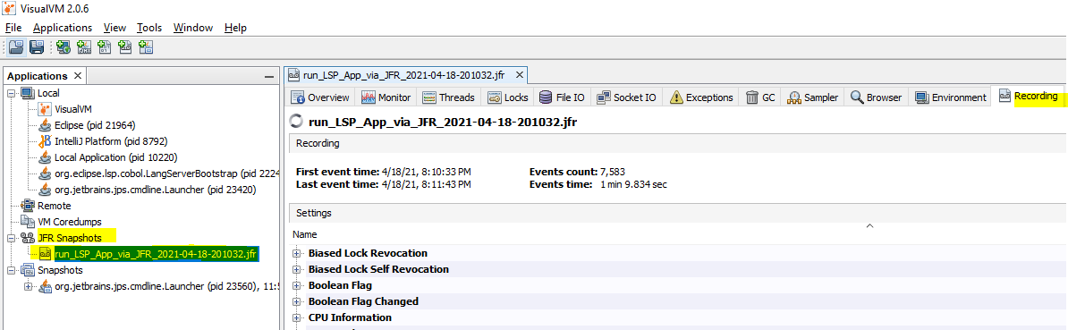
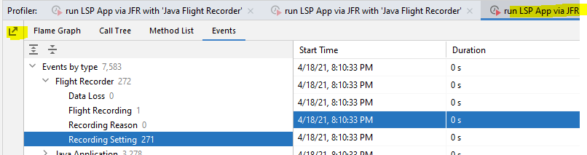
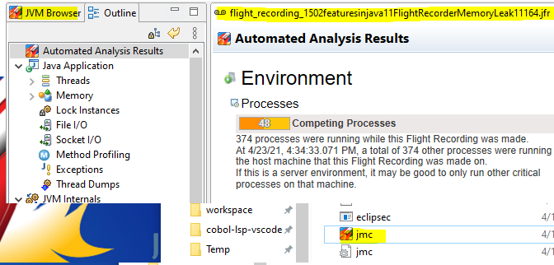
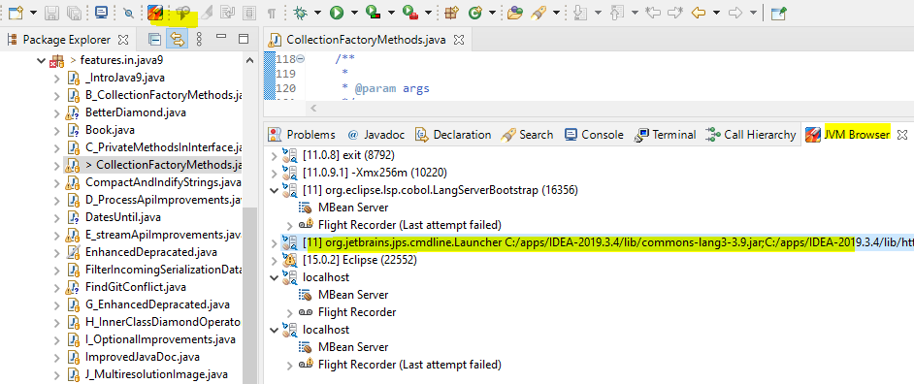
New Features in JAVA 11
Java Flight Recorder:
(Telemetry events)
Java Mission Control:
To see JFR output from .jsr file
JFR is a tool for collecting diagnostic and profiling data about a running Java application.
- Supports Java Flight Recorder.
- Supports HotSpot VM, since JDK 7
JCMD – Running Java process
>jcmd
>jcmd 11164 JFR.start duration=30s settings=profile filename=C:/workspace-JavaNew/Java-Features/leak.jfr
Notes:
JFR - It is available since Java 7 and became open source in 2018 with the Java 11 release.
JFR – is low overhead DATA COLLECTION Framework (telemetry). Used to get metrics on your JVMs.
Implemented as Bounded circular buffer which buffers internal JVM metrics for a configurable amount of minutes.
You can leave it ON in production system, because it is so overhead.
Java Mission Control – It analysis DUMPs from JFR, and gave graphical overview of what is happening inside JVM.
Java Flight Recorder (JFR) was a commercial product in Oracle JDK, now it is open source in OpenJDK 11. This JFR is a profiling tool that used to diagnose a running Java application.
The below command starts a 60 seconds JFR recording on a Java application, dumps the recorded data into a ‘.jfr’ file.
So what to do with the .jfr file? We
https://mkyong.com/java/java-11-java-flight-recorder/can use Java Mission Control (JMC) to analyze and visualize the .jfr file.
For the running Java process or application, we can use jcmd to start a JFR recording and dumps the data to a .jfr file. This jcmd is available in the JDK 11/bin, not JRE.

Slide 40
New Features in JAVA 12
Features
189: Shenandoah: A Low-Pause-Time Garbage Collector (Experimental)
230: Microbenchmark Suite
325: Switch Expressions (Preview)
334: JVM Constants API
340: One AArch64 Port, Not Two
341: Default CDS Archives
344: Abortable Mixed Collections for G1
346: Promptly Return Unused Committed Memory from G1
Source code: https://github.com/azatsatklichov/Java-Features/tree/master/src/main/java/features/in/java12
Notes:
https://mkyong.com/java/what-is-new-in-java-16/#jep-392-packaging-tool

Slide 41
New Features in JAVA 12
Language and Library Improvements, Additions
String::indent, ::transform
Compact Number Formats – e.g. 1000 -> 1K, 1Mio. -> 1M .
NumberFormat.getCompactNumberInstance(); NumberFormat::setRoundingMode, setMaximumFractionDigits(2)
Teeing Collector - Collectors.teeing(c1, c2, combine)
Files::mismatch - Files.mismatch(Path.of("/file1"), Path.of("/file2));
Preview Feature – Experimental (like incubator modules), Opt: --enable-preview
Switch Expressions
Current ‘Switch Statement” - No return value, just fall through, can not define new scope (local variable)
New Switch Expression (means value, or returns value) No fall through, return value, combine labels, block scope
Standardized in Java 14
@SuppressWarnings("preview")
public static String getDay(Day d) {
String day = switch (d) {
case SUN -> "Sunday";
case MON -> "Monday";
case TUE -> "Tuesday";
};
return day;
}
Notes:
Files.mismatch(Path.of("/file1"), Path.of("/file2));

Slide 42
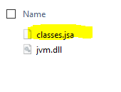
New Features in JAVA 12
One AArch64 Port, Not Two
Before Java 12, there are two different source code or ports for the 64-bit ARM architecture.
- Oracle – src/hotspot/cpu/arm
- Red Hat – src/hotspot/cpu/aarch64
In Java 12 Oracle src/hotspot/cpu/arm port is removed, and maintain only one port src/hotspot/cpu/aarch64, and
make this aarch64 the default build for the 64-bit ARM architecture.
Default CDS Archives (became standard in Java 13)
Improved the start-up time by reuse an existing archive file.
Before Java 12, we need to use -Xshare: dump to generate the CDS archive file for the JDK classes. Since Java 12 a new classes.jsa file in the /bin/server/ directory, a default CDS archive file for the JDK classes.
Notes:
https://openjdk.java.net/jeps/341

Slide 43
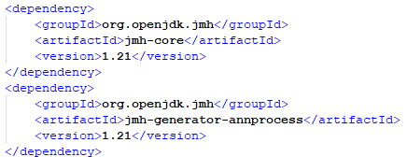
New Features in JAVA 12
//Don't Do This - via System.currentTimeMillis()
//e.g. no consider optimizations, etc. ..
long start = System.currentTimeMillis();
//code under benchmark
long end = System.currentTimeMillis();
long elapsed = end - start;
System.out.println("Elapsed time: " + elapsed);
Micro Benchmarking with JMH
JMH is a Java harness for building, running, and analysing nano/micro/milli/macro benchmarks written in Java and other languages targetting the JVM.
Measure exec-time, compare alternatives, prevent performance regressions
JMH – Reproducability, JVM warm-up handling, cocnsistent reporting, multithreading support
Pitfalls: Dead code eliminations, other compiler optimizations, assumptions
JVM Improvements
JEP 344: Abortable Mixed Collections for G1: Splits the problematic collection set into two parts – mandatory and optional. The G1 will abort the optional part if lack of time to handle it.
JEP 346: Promptly Return Unused Committed Memory from G1
New GC (experimental) – Shenandoah [Brooks pointers] support large Heaps, Low pause times.
Contributed by RedHat to OpenJDK. Became product feature in Java 15. Oracle JDK and Open JDK has not this feature.
-XX:+UnlockExperimentalVMOptions -XX:+UseShenandoahGC
JVM Constants API – java.lang.constant (ConstantDesc <- ClassDesc, String, MethodTypeDesc )
Notes:
This JEP 346 improves the performance of the Garbage-first (G1) collector. If the application is low of the activity or idle, G1 periodically trigger a concurrent cycle to determine overall Java heap usage and return unused Java heap memory to the operating system.
Promptly Return Unused Committed Memory from G1
Shenandoah is a new low-pause and concurrent garbage collector, read this research paper, it reduces GC pause time and independent of the Java heap size (5M or 5G of heap size have the same pause time, useful for large heap applications.)
This GC is an experimental feature, and we need to use the following options to enable the new Shenandoah GC.
Added a range of Java Microbenchmark Harness (JMH) benchmarks to the JDK source code, for those interested to add or modify the JDK source code itself, now they have a way to compare the performance.
A new package java.lang.constant, a list of new classes and interfaces to model the key class-file and run-time artifacts, for example, the constant pool.
This JEP improves the performance of the Garbage-first (G1) collector, by splits the problematic collection set into two parts – mandatory and optional. The G1 will abort the optional part if lack of time to handle it.

Slide 44
New Features in JAVA 13
Features
350: Dynamic CDS Archives
351: ZGC: Uncommit Unused Memory
353: Reimplement the Legacy Socket API
354: Switch Expressions (Preview)
355: Text Blocks (Preview)
Source code: https://github.com/azatsatklichov/Java-Features/tree/master/src/main/java/features/in/java13
Notes:
https://mkyong.com/java/what-is-new-in-java-16/#jep-392-packaging-tool

Slide 45
New Features in JAVA 13
Java 13 All Features: https://github.com/azatsatklichov/Java-Features
Language API Updates
ByteBuffer Improvements - ByteBuffer != byte[] etc.
Removed javax.security.cert - javax.security.cert.Certificate, javax.security.cert.X509Certificate
Unicode 12.1 Support
555 new chars, 4 new scripts, 61 new emojis, CLDR 35.1 Japanese new rra, Reiwa
JVM Improvements
ZGC: Uncommit Unused Memory (returns back to Main memory) -XX:ZUncommitDelay=<seconds> . ZGC was introduced in Java 11 and was lack of return un-used memory but providing a short pause times when cleaning up heap memories.
Preview Feature – Experimental (like incubator modules), Opt: --enable-preview
Switch Expressions (since Java 12 still as preview feature )
Current ‘Switch Statement” - No return value, just fall through, can not define new scope (local variable)
New Switch Expression (means value, or returns value) – No fall through, return value (yield), combine labels, block scope
Dropped “break value” favor of added “yield” keyword to return value from switch expression
Standardized in Java 14
@SuppressWarnings("preview")
public static String getDay(Day d) {
String day = switch (d) {
case SUN -> "Sunday";
case MON -> "Monday";
case TUE -> "Tuesday";
};
return day;
}
Notes:
https://openjdk.java.net/jeps/351

Slide 46
New Features in JAVA 13
Preview Feature – Experimental (like incubator modules), Opt: --enable-preview
Text blocks (multi line Strings) - At runtime works as regular string, no runtime overhead
Normalizes line endings (always Unix style \r), trim white space, translate escape sequence
As being experimental, provides @Deprecated methods: html.stripIndent(), text.translateEscapes() , formatted()
Standardized in Java 15
Platform Changes
Re-implementation of Socket API (exists since JDK 1.0, mix of legacy Java & C) - java.net.Socket, ServerSocket
Modern and more maintainable implementation , not using stack as I/O buffer
Made ready for new Java Concurrency models - see project Loom
sun.nio.ch.NioSocketImpl, replacement for PlainSocketImpl, reuses NIO native code, built using java.concurrent.lock
To switch back to old PlainSocketImpl: -Djdk.net.usePlainSocketImpl
See Java 15 for Reimplement the Legacy DatagramSocket API (java.net.DatagramSocket, MulticastSocket APIs)
Class Data Sharing – ACDS (Firstly in introduced in Java 10 as preview)
CDS introduced in Java 10, improves startup performance by creating a class-data archive once and reusing it so that the JVM needs not to recreate it again. The primary motivation for including CDS in Java SE is to decrease in startup time
ACDS added in Java 13. Also supports classes in custom class loaders
This command creates CDS archive file: java -XX:ArchiveClassesAtExit=hello.jsa -cp hello.jar Hello
This command runs a .jar with an existing CDS archive file: bin/java -XX:SharedArchiveFile=hello.jsa -cp hello.jar Hello
Deprecated flags: -Xverify:none, -noverify
Use AppCDS instead for upfront verification
Notes:
Java 13 introduced a new NioSocketImpl class as a drop-in replacement for PlainSocketImpl.
However, if something goes wrong, we can still switch back to the old implementation PlainSocketImpl by setting jdk.net.usePlainSocketImpl system property.
The new implementation will be easy to adapt to work with user-mode threads, a.k.a. fibers, currently being explored in Project Loom.

Slide 47
New Features in JAVA 14
305:Pattern Matching for instanceof (Preview)
343:Packaging Tool (Incubator)
345:NUMA-Aware Memory Allocation for G1
349:JFR Event Streaming
352:Non-Volatile Mapped Byte Buffers
358:Helpful NullPointerExceptions
359:Records (Preview)
361:Switch Expressions (Standard)
362:Deprecate the Solaris and SPARC Ports
363:Remove the Concurrent Mark Sweep (CMS) Garbage Collector
364:ZGC on macOS
365:ZGC on Windows
366:Deprecate the ParallelScavenge + SerialOld GC Combination
367:Remove the Pack200 Tools and API
368:Text Blocks (Second Preview)
370:Foreign-Memory Access API (Incubator)
Features
Source code: https://github.com/azatsatklichov/Java-Features/tree/master/src/main/java/features/in/java14
Notes:
https://mkyong.com/java/what-is-new-in-java-16/#jep-392-packaging-tool

Slide 48
New Features in JAVA 14
Java 14 All Features: https://github.com/azatsatklichov/Java-Features
Language API Updates
Removed - java.security.acl, java.util.jar, Pack200.{Packer, Unpacker}
Deprecated for removal - Thread::suspend, Thread::resume
Deprecated - Solaris, SPARC ports
PrintStram – new added metods write(byte[] buf) throws IOException, same but no ex. writeBytes(byte[] buf)
@java.io.Serial, -Xlint:serial : @Serial private static final long serialVersionUID = 63L;
Informative NullPointer Exceptions
x().y().z() – just says NPE, workaround – assign it to separate variable
java -XX:+ShowCodeDetailsInExceptionMessages Example
var a = null; a.b = 1; //Exception in thread "main" java.lang.NullPointerException: Cannot assign field "b" because "a" is null
var a = new Object[][] { null }; a[0][1] = new Object(); //… Cannot store to object array because "a[0]" is null because "a" is null
Switch Expressions (now standardized, since Java 12,13 was preview, was keeps improving and getting feedbacks)
Able to write switch expression via mixing old-and-new ways. But avoid mixing both see ERR
String monthName = switch (monthNumber) { case 1: yield "January"; case 2: yield "February"; // rest of cases default: yield "Unknown"; }; | String monthName; switch (monthNumber) { case 1 -> monthName = "January"; case 2 -> monthName = "February"; } | String monthName; switch (monthNumber) { case 1 -> monthName = "January"; case 2 -> monthName = "February"; case 3: monthName = "March"; //ERR }
Notes:
String monthName;
switch (monthNumber) {
case 1 -> monthName = "January";
case 2 -> monthName = "February";
case 3: monthName = "March"; //ERR
}
Dropping support for Solaris/SPARC, Solaris/x64, and Linux/SPARC ports, fewer platforms support means faster delivery for new features.
P.S Java 15 JEP 381 removed the above ports.
Goals
Remove all source code specific to the Solaris operating system
Remove all source code specific to the SPARC architecture
Update documentation and source code comments for future releases

Slide 49
New Features in JAVA 14
Preview Feature – Experimental (like incubator modules), Opt: --enable-preview --release 14
Pattern Matching
if (object instanceof BigDecimal) { BigDecimal b = (BigDecimal) object; return b.precision(); } | if (object instanceof BigDecimal b) { return b.precision(); } | int value = switch (object) { case BigDecimal b -> b.intValue(); case String s -> Integer.parseInt(s); case Integer i -> i; }
Text Blocks (multiline ) – Second Preview feature since Java 13
added two more new escape sequences:
1) \<end-of-line> suppresses the line termination. 2) \s is translated into a single space.
Packaging Tools - create platform-specific installers/packages. Win (MSI/EXE), MacOS (PKG/DMG), Linux (DEB/PRM)
jpackage --input hello --name hello --main-jar hello.jar --main-class pkg.Hello --type dmg
//https://github.com/wixtoolset/wix3/releases/tag/wix3112rtm – wix311.exe
Records
A record class is a shallowly immutable, transparent carrier for a fixed set of values, called the record components.
Components, constructor, equals/hashCode/toString, accessors without getX(way but just via name() )
Notes:
int value = switch (object) { case BigDe
cimal b -> b.intValue(); case String s -> Integer.parseInt(s); case Integer i -> i; }

Slide 50
New Features in JAVA 14
JVM Improvements
NUMA aware memory allocation for G1 - improve performance on large machines: -XX:+UseNUMA
ZGC (since Java 11) [pause ime under 10 ms, maybe in future 1 ms] Scale to multi-terabyte heaps, Colored Pointers
Before Linux/x64 only, now supports Win&MacOS
Concurrent Mark Sweep (CMS) GC is removed: -XX:+UseConcMarkSweepGC // U get w: support was removed in 14.0
Deprecate the ParallelScavenge + SerialOld GC Combination: Due to less use and high maintenance effort, Java 14 deprecates the combination of the parallel young generation and serial old generation GC algorithms.
Other Improvements
Non-Volatile Mapped Byte Buffers (JEP-352) - Improved FileChannel API to ceate MappedByteBuffer
Foreign-Memory Access API (Incubator, JEP-370)
Java Flight Recorder Event Streaming (JEP-349)
Notes:
int value = switch (object) { case BigDecimal b -> b.intValue(); case String s -> Integer.parseInt(s); case Integer i -> i; }
Improved the existing JFR to support event streaming, it means now we can stream the JFR events in real-time, without the need to dump the recorded events to disk and parse it manually.
The JDK Flight Recorder (JFR) is a tool for collecting diagnostic and profiling data about a running Java application.
Normally, we start a recording, stop it, dump the recorded events to disk for parsing, it works well for profiling, analysis, or debugging.
Improved FileChannel API to ceate MappedByteBuffer
JEP 352: Non-Volatile Mapped Byte Buffers
Improved FileChannel API to create MappedByteBuffer that access to non-volatile memory (NVM) – a memory that can retrieve stored data even after having been power cycled. For example, this feature ensures that any changes which might still be in the cache are written back to memory.
Java 11 JEP 333 introduced the Z Garbage Collector (ZGC) on Linux, and now it ports to macOS.
P.S This ZGC is a product feature in Java 15 JEP 377.
Java 11 JEP 333 introduced the Z Garbage Collector (ZGC) on Linux, and now it ports to Windows version >= 1803.

Slide 51
New Features in JAVA 15
Features
339: Edwards-Curve Digital Signature Algorithm EdDSA)
360: Sealed Classes (Preview)
371: Hidden Classes
372: Remove the Nashorn JavaScript Engine
373: Reimplement the Legacy DatagramSocket API
374: Disable and Deprecate Biased Locking
375: Pattern Matching for instanceof (Second Preview)
377: ZGC: A Scalable Low-Latency Garbage Collector
378: Text Blocks
379: Shenandoah: A Low-Pause-Time Garbage Collector
381: Remove the Solaris and SPARC Ports
383: Foreign-Memory Access API (Second Incubator)
384: Records (Second Preview)
385: Deprecate RMI Activation for Removal
Source code: https://github.com/azatsatklichov/Java-Features/tree/master/src/main/java/features/in/java15
Notes:
https://mkyong.com/java/what-is-new-in-java-16/#jep-392-packaging-tool

Slide 52
New Features in JAVA 15
Java 15 All Features: https://github.com/azatsatklichov/Java-Features
Deprecations and Removals
Removed JDK ports - Solaris, SPARC: Solaris/SPARC, Solaris/x64, and Linux/SPARC ports and now it is officially removed
RMI deprecations - java.rmi.activation, and the tool ‘rmid’ is also deprecated, but tool ‘rmic’ is removed
Nashorn JS Engine – removed, also the tool ‘jjs’ is removed. Alternative see: GraalVM (Graal.js), Project Detroit (V8
This JEP also removed the below two modules: jdk.scripting.nashorn.shell – contains the jjs tool and
jdk.scripting.nashorn – contains the jdk.nashorn.api.scripting and jdk.nashorn.api.tree packages.
Disable and Deprecate Biased Locking
enabled: -XX:+UseBiasedLocking -XX:BiasedLockingStartupDelay=0 disabled: -XX:-UseBiasedLocking
Informative NullPointer Exceptions (was preview since Java 14)
No need: -XX:+ShowCodeDetailsInExceptionMessages, it is already default in Java
Text Blocks – Multiline Strings (was preview in Java 13, 14)
Now officially part of Java 15. Support multi-line strings in source code. Text block results in a regular string
Hidden Classes
JEP 371 defines hidden classes that are not discoverable and have a limited lifecycle (shorter live), good for developers that generate classes dynamically at runtime. This JEP also deprecated the Unsafe.defineAnonymousClass API and marked it for removal in the future.
Notes:
JEP 374: Disable and Deprecate Biased Locking
This JEP disable and deprecated the biased locking by default. Before Java 15, the biased locking is always enabled by default, giving performance gains for synchronized stuff.
The older or legacy Java application uses synchronize collections APIs like Hashtable and Vector, and the biased locking may giving performance gains. Nowadays, the newer Java application generally uses the non-synchronized collections HashMap and ArrayList, and the performance gains of biased locking are generally less useful now.
However, for Java 15, we still can enable the biased locking by using -XX:+UseBiasedLocking, but it will prompt VM warning for deprecated API.
Solaris/SPARC, Solaris/x64, and Linux/SPARC ports and now it is officially removed

Slide 53
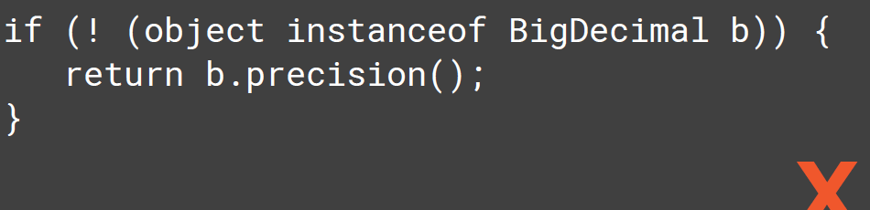
New Features in JAVA 15
Second Preview Features, since Java 14
Pattern Matching
if (object instanceof BigDecimal) { BigDecimal b = (BigDecimal) object; return b.precision(); } | if (object instanceof BigDecimal b) { return b.precision(); } | int value = switch (object) { case BigDecimal b -> b.intValue(); case String s -> Integer.parseInt(s); case Integer i -> i; }
Records
A record class is a shallowly immutable, transparent carrier for a fixed set of values, called the record components.
Components, constructor, equals/hashCode/toString, accessors without getX(way but just via name() )
This JEP enhanced the records with features like support sealed types, local records, annotation on records, and Reflection APIs for records. Also local interfaces and enums also allowed) in Java 15:
public void myMethod() {
record Point(int x, int y) {} //implicitly static
Point p = new Point(1, 1); //
}
Sealed Classes (Preview in Java 15) – Immutable classes are too strong (final can not be inherited)
//Before public abstract class Option<T> { private Option() {} public final static class Some<T> extends Option<T> { ... } public final static class Empty extends Option<Void> { ... } // ... } | //with Sealed classes – Sum type (math) public sealed class Option<T> permits Some, Empty { // .. } public final class Empty extends Option<Void> { // .. } //same for Some .. | //or other way public sealed class Option<T> { // .. In the same source file, permits is optional public final static class Empty extends Option<Void> {} public final static class Some<T> extends Option<T> {} }
Notes:
int value = switch (object) { case BigDecimal b -> b.intValue(); case String s -> Integer.parseInt(s); case Integer i -> i; }
A new class called record (aka data class), it is a final class, not abstract, and all of its fields are final as well.
The record will automatically generate the tedious constructors, public get, equals(), hashCode(), toString() during compile time.

Slide 54

New Features in JAVA 15
JVM Improvements
ZGC (since Java 11, .. 14) – now in Java 15 can be used in production
Shenandoah [Since Java 12] Developed by Red Hat, contributed to OpenJDK
Backported to Java 8, 11 . -XX:+UseShenandoahGC //only supported, RedHat OpenJDK
Became product feature in Java 15. Oracle JDK and Open JDK has not this feature.
No more: java -XX:+UnlockExperimentalVMOptions -XX:+UseShenandoahGC
Just set -XX:+UseShenandoahGC to enable the Shenandoah GC
Foreign-Memory Access API (Second Incubator, JEP-383 since Java 14) made some changes to the APIs, and it will be still in incubator modules.
Other Improvements
Hidden classes (JEP-371)
Edwards-Curve Digital Signature Algorithm (EdDSA) (JEP-339)
Re-Implemented the Legacy DatagramSocket API (JEP-373) (java.net.DatagramSocket, MulticastSocket APIs)
See Java 13 for Re-implementation of Socket API - java.net.Socket, ServerSocket
Notes:
int value = switch (object) { case
BigDecimal b -> b.intValue(); case Strin
g s -> Integer.parseInt(s); case Integer i -> i; }
Disable and Deprecate Biased Locking
-XX:+UseShenandoahGC to enable the Shenandoah GC

Slide 55
New Features in JAVA 16
Features
https://mkyong.com/java/what-is-new-in-java-16/#jep-392-packaging-tool
338: Vect or API (Incubator)
347: Enable C++14 Language Features
357: Migrate from Mercurial to Git
369: Migrate to GitHub
376: ZGC: Concurrent Thread-Stack Processing
380: Unix-Domain Socket Channels
386: Alpine Linux Port
387: Elastic Metaspace
388: Windows/AArch64 Port
389: Foreign Linker API (Incubator)
390: Warnings for Value-Based Classes
392: Packaging Tool
393: Foreign-Memory Access API (Third Incubator)
394: Pattern Matching for instanceof
395: Records
396: Strongly Encapsulate JDK Internals by Default
397: Sealed Classes (Second Preview)
Java 16 developer features.
jpackage, records (standard),
pattern matching (standard),
sealed types (second preview),
foreign-memory access APIs (third incubator), foreign linker APIs to replace JNI (incubator),
vector APIs (incubator)
Source code: https://github.com/azatsatklichov/Java-Features/tree/master/src/main/java/features/in/java16
Notes:
https://mkyong.com/java/what-is-new-in-java-16/#jep-392-packaging-tool

Slide 56
New Features in JAVA 16
Vector API (Incubator)
Java supports auto vectorization to optimize the arithmetic algorithms, which means the Java (JIT compiler) will transform some scalar operations (one item at a time) into vector operations (multiple items at a time) automatically; However, the developers have no control of this vector operation conversion, it totally depends on the JIT compiler to optimize the code, furthermore, not all scalar operations are transformable.
This JEP introduces new Vector APIs to allow developers to perform the vector operations explicitly.
A Vector processor processes multiple data at a time, known as single instruction, multiple data (SIMD).
A Scalar processor processes only one data at a time, known as single instruction, single data (SISD).
Migrate from Mercurial to Git. I used Mercurial in Gemalto ;)
This JEP migrate the OpenJDK source code from Mercurial to Git or GitHub, relates to the below JEP 369
The reasons for migrating to Git:
File size of version control system metadata (Mercurial) is too big.
Available tooling
Available hosting
Notes:
int value = switch (object) { case
BigDecimal b -> b.intValue(); case Strin
g s -> Integer.parseInt(s); case Integer i -> i; }
Disable and Deprecate Biased Locking
-XX:+UseShenandoahGC to enable the Shenandoah GC

Slide 57
New Features in JAVA 16
JEP 380: Unix-Domain Socket Channels
The Unix-domain sockets are used for inter-process communication (IPC) on the same host, which means exchanging data between processes executing on the same host. The Unix-domain sockets are similar to TCP/IP sockets except that they are addressed by filesystem pathnames rather than the Internet Protocol (IP) addresses and port numbers. Most Unix platforms, Windows 10 and Windows Server 2019, also supported the Unix-domain sockets.
This JEP add Unix-domain (AF_UNIX) socket support to the existing SocketChannel and ServerSocketChannel.
New Unix-domain Socket classes or APIs:
New socket address class, java.net.UnixDomainSocketAddress
New enum, java.net.StandardProtocolFamily.UNIX
JEP 386: Alpine Linux Port
This JEP port the JDK to Alpine Linux and other Linux distributions that use musl implementation. This JDK port enables Java to run out-of-the-box in Alpine Linux, which benefits those Java-dependent frameworks or tools like Tomcat and Spring.
P.S The Alpine Linux contains small image size, widely adopted in cloud deployments, microservices, and container environments.
JEP 387: Elastic Metaspace
Java 8 JEP 122 removed the PermGen (Permanent Generation), and introduced Metaspace, a native off-heap memory manager in the hotspot.
This JEP improves the metaspace memory management by returning unused HotSpot class-metadata or metaspace memory to the operating system more promptly, reducing the metaspace footprint, and simplifying the metaspace code.
Notes:
int value = switch (object) { case
BigDecimal b -> b.intValue(); case Strin
g s -> Integer.parseInt(s); case Integer i -> i; }
Disable and Deprecate Biased Locking
-XX:+UseShenandoahGC to enable the Shenandoah GC

Slide 58
New Features in JAVA 16
JEP 388: Windows/AArch64 Port
This JEP port the JDK to Windows/AArch64, running JDK + Windows on ARM hardware, server, or ARM-based laptop.
P.S The Windows/AArch64 is a popular demand in the end-user market.
JEP 389: Foreign Linker API (Incubator)
This JEP enables Java code to call or can be called by native code written in other languages like C or C++, replace Java Native Interface (JNI)
P.S This is an incubating feature; need add --add-modules jdk.incubator.foreign to compile and run the Java code.
10.1 Below example shows how to use the foreign linker APIs to call the standard C library strlen to return the string’s length.
Notes:
int value = switch (object) { case
BigDecimal b -> b.intValue(); case Strin
g s -> Integer.parseInt(s); case Integer i -> i; }
Disable and Deprecate Biased Locking
-XX:+UseShenandoahGC to enable the Shenandoah GC

Slide 59
New Features in JAVA 17 – LTS Release
Features
306: | Restore Always-Strict Floating-Point Semantics
356: | Enhanced Pseudo-Random Number Generators
382: | New macOS Rendering Pipeline
391: | macOS/AArch64 Port
398: | Deprecate the Applet API for Removal
403: | Strongly Encapsulate JDK Internals
406: | Pattern Matching for switch (Preview)
407: | Remove RMI Activation
409: | Sealed Classes
410: | Remove the Experimental AOT and JIT Compiler
411: | Deprecate the Security Manager for Removal
412: | Foreign Function & Memory API (Incubator)
414: | Vector API (Second Incubator)
415: | Context-Specific Deserialization Filters
Source code: https://github.com/azatsatklichov/Java-Features/tree/master/src/main/java/features/in/java17
Notes:
https://mkyong.com/java/what-is-new-in-java-16/#jep-392-packaging-tool

Slide 60
New Features in JAVA 17
JEP 388: Windows/AArch64 Port
This JEP port the JDK to Windows/AArch64, running JDK + Windows on ARM hardware, server, or ARM-based laptop.
P.S The Windows/AArch64 is a popular demand in the end-user market.
https://www.oracle.com/emea/news/announcement/oracle-releases-java-17-2021-09-14/

Slide 61

THANK YOU
References
https://www.baeldung.com/oracle-jdk-vs-openjdk
https://medium.com/@javachampions/java-is-still-free-c02aef8c9e04
https://www.journaldev.com/13106/java-9-modules

